Slide 1

The Learning Context
Stephen Downes
December 2, 2021

Slide 2
The Learning Context
AI Does Not Operate in a Vacuum – “learning analytics needs to build on and better connect with the existing body of research knowledge about learning and teaching.”
Key Questions Include:
  What are we trying to do
  What are we trying to measure or predict?
  Who is involved?
Dragan Gašević, Shane Dawson, George Siemens,2015 https://www.sfu.ca/~dgasevic/papers_shared/techtrends2015.pdf
Title Image: https://static.businessworld.in/article/article_extra_large_image/1502190988_tdOhIl_Startup_Management_Sht_470.jpg

Slide 3
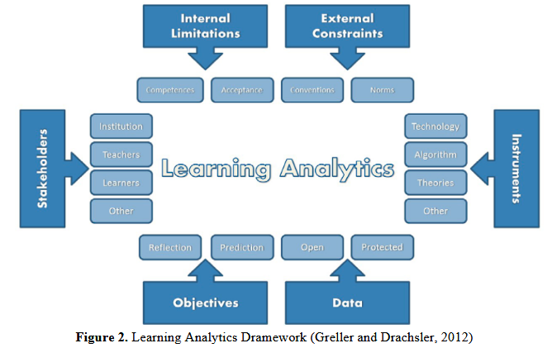
The Learning Context
Theory
Objectives
Stakeholders
Constraints
“Starts with framework provided by Greller and Drachsler (2012). This pedagogical model contains six dimensions: competences, constraints, method, objectives (distinguishing between reflection and prediction), data, and stakeholders.” (Seufert, et.al., 2019).

Slide 4

Stakeholders

Slide 5
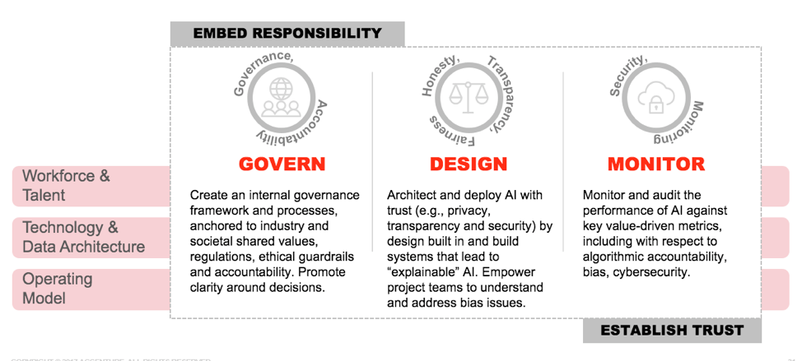
Responsibility for AI
“Complicity here means that the responsibility for AI is shared by individuals involved in its development and deployment, regardless of their particular intentions, simply because they know enough about the potential harms.” (Zimmerman, et.al., 2020)
Joshua Kroll: “While structural inscrutability frustrates users and oversight entities, system creators and operators always determine that the technologies they deploy are fit for certain uses, making no system wholly inscrutable.”
https://insuranceblog.accenture.com/approaching-artificial-intelligence-the-responsible-way

Slide 6
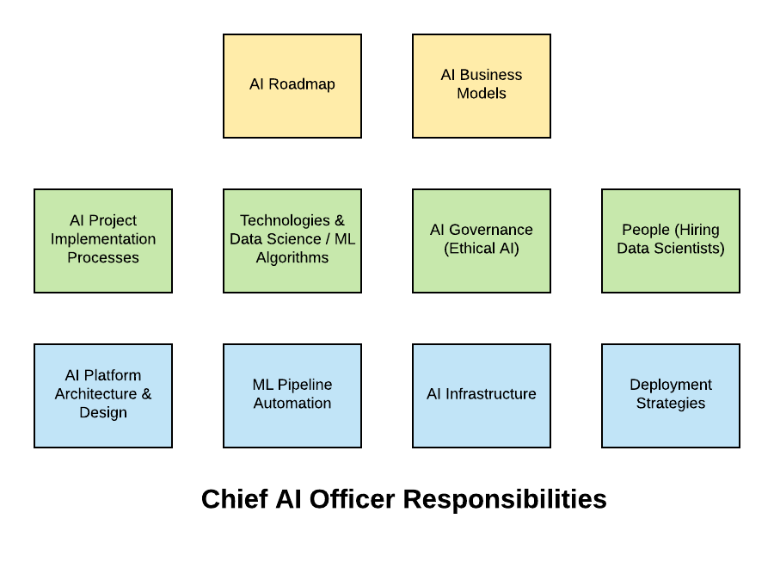
Chief AI Officer
“AI governance (ethical AI), automation of AI/ML pipeline, infrastructure management vis-a-vis usage of cloud services, unique project implementation methodologies etc.”
https://vitalflux.com/job-description-chief-artificial-intelligence-officer/

Slide 7
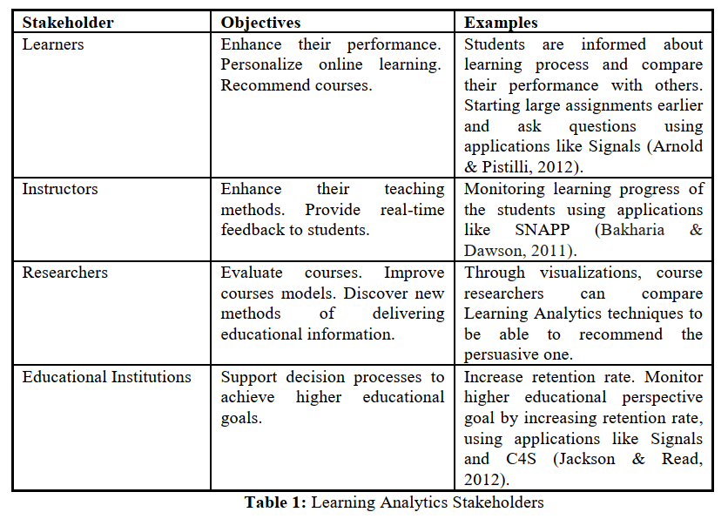
Mohammad Khalil, Martin Ebner, 2015.
Learning Analytics: Principles and Constraints https://www.researchgate.net/publication/278940599_Learning_Analytics_Principles_and_Constraints

Slide 8

Data Subjects, Data Clients
Data subjects: a group of learners Data clients: Teachers, tutors, discussion moderators (Seufert, et.al., 2019)
GDPR:
  Data subjects—those for whom GDPR was written to protect
  Data controllers—those that make the decisions about personal data processing
  Data processors—those to whom controllers have outsourced processing activities
Sheila Jambekar, 2017-10-04, GDPR: Data Subjects, Controllers and Processors, Oh My! https://www.twilio.com/blog/2017/10/gdpr-data-subjects-controllers-processors.html

Slide 9

Stakeholder Issues
The prioritization of, say, institutional stakeholders may lead to undesirable outcomes. (Jaschik, 2016)
Zeide (2019) writes, “the president of Mount St. Mary's University, in Maryland, administered a predictive analytics test to see which students were most at risk of failing. The idea was to encourage them to drop out before the university was required to report its enrollment numbers to the federal government, thereby creating better retention numbers and improving its rankings.”
https://theconversation.com/why-suspending-or-expelling-students-often-does-more-harm-than-good-93279

Slide 10
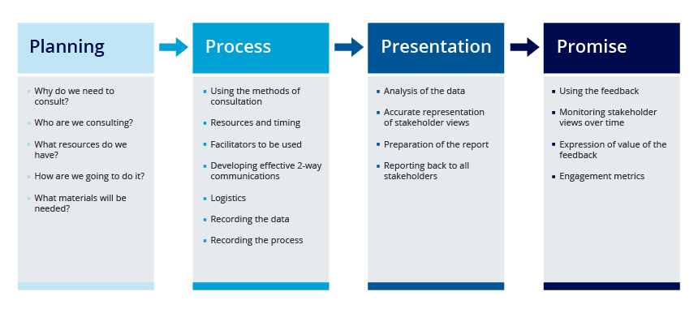
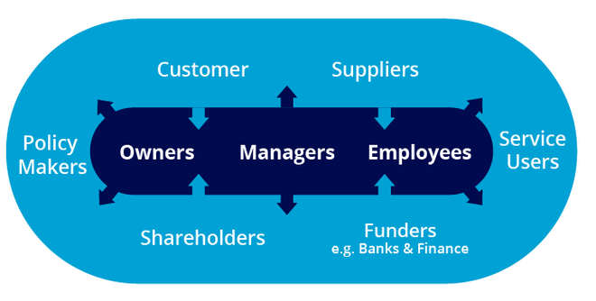
Multistakeholder Collaboration
“Encouraging or requiring that designers and users of AI systems consult relevant stakeholder groups while developing and managing the use of AI applications.” (Fjeld, et.al., 2020:58)
  Can be a tool-specific or general policy vision
https://www.b2binternational.com/publications/stakeholder-research/

Slide 11
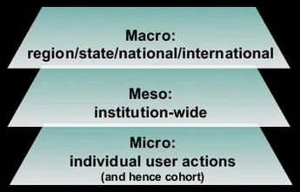
Levels of Analysis
s
Simon Buckingham Shim, 2012 https://www.slideshare.net/sbs/our-learning-analytics-are-our-pedagogy

Slide 12
Different Uses, Different Users
Lust et al. (2013) – Four groups of users:
  no‐users, low level adoption of any tool in the LMS suggested to them in the course design (e.g., quizzes, web lectures, and discussion forums);
  intensive active learners – used all tools suggested by the course design and used those tools actively;
  selective users – only used a selected number of tools offered to them;
  intensive superficial users – used all the tools and spent more time than other groups, predominantly on cognitively passive activities such as reading discussion posts in lieu of contributing to the forum.
Dragan Gašević, Shane Dawson, George Siemens, https://www.sfu.ca/~dgasevic/papers_shared/techtrends2015.pdf
Lust, G., Elen, J., & Clarebout, G. (2013). Students’ tool‐use within a web enhanced course:
Explanatory mechanisms of students’ tool‐use pattern. Computers in Human Behavior, 29(5),
2013–2021. doi:10.1016/j.chb.2013.03.014

Slide 13
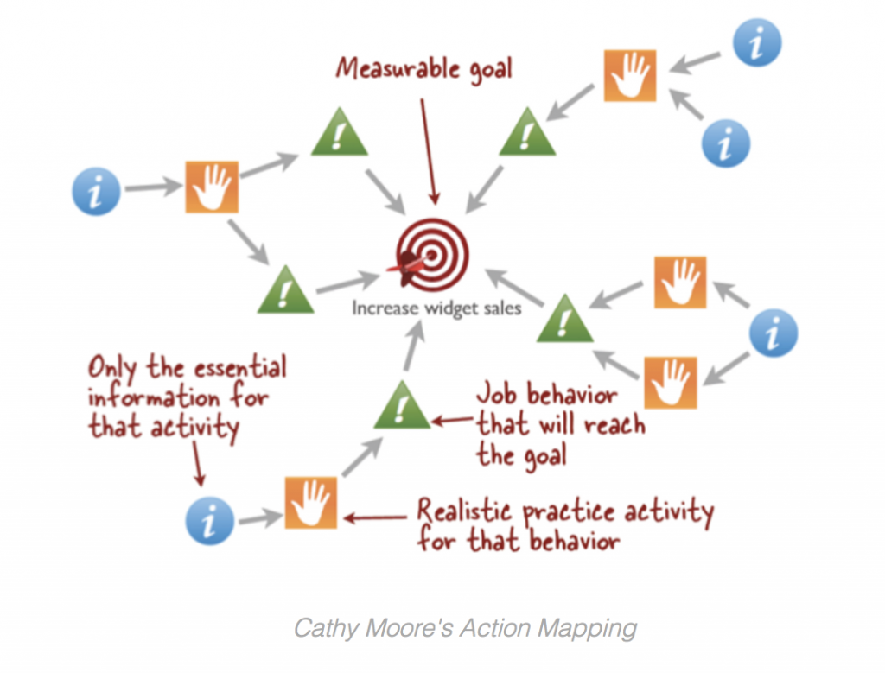
Learning Design Teams
“The ‘inclusiveness in design’ principle stands for the idea that ethical and rights-respecting AI requires more diverse participation in the development process for AI systems. This principle is expressed in two different ways. The first and more common interpretation calls for diverse AI design teams.” (Fjeld, et.al., 2020:52)
https://getsynapse.com/blog/the-ultimate-guide-to-instructional-design-models/

Slide 14

Objectives

Slide 15
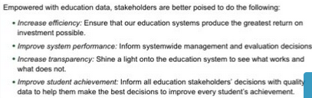
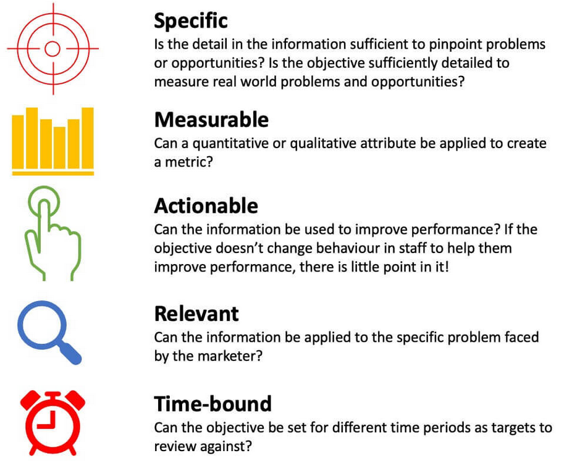
Broad Objectives
Simon Buckingham Shum, 2012 https://www.slideshare.net/sbs/our-learning-analytics-are-our-pedagogy
SMART Objectives
https://www.smartinsights.com/goal-setting-evaluation/goals-kpis/define-smart-marketing-objectives/

Slide 16
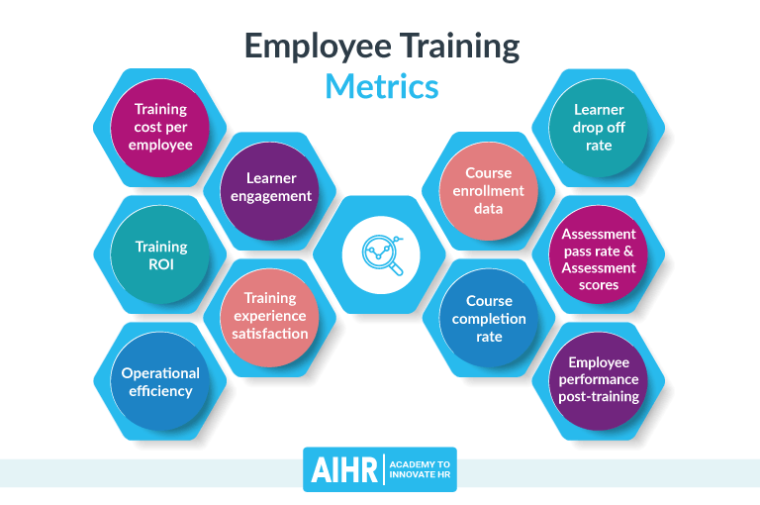
Metrics
https://www.aihr.com/blog/training-metrics/

Slide 17
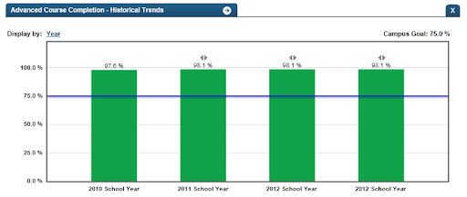
Course Completion
Course completion as a proxy for learning?
http://castro.tea.state.tx.us/tsds/metrics/metricsdb_docs/documentation/metrics/303https://www.ottolearn.com/post/08-are-course-completions-a-vanity-metric

Slide 18



Public Good
Start with public good. “Design usually starts with a ‘discovery’ period of qualitative research into people's lived experience.” (Drew, 2018)
“Data projects can often start with the data (and well-meaningfully, with the aim for social good).
  At worst, the process could involve simply playing with a dataset
  At best, the process would be motivated by a clear public benefit
https://www.un.org/sustainabledevelopment/

Slide 19

Theory

Slide 20

Pedagogic Theory and Learning Design
Analogy: teaching to the test rather than teaching to improve understanding
  “learning analytics that do not promote effective learning and teaching are susceptible to the use of trivial measures such as increased number of log‐ins into an LMS”
Many things are counted, but few have any bearing on theory or practice (Wilson, 1999, p. 250)
Dragan Gašević, Shane Dawson, George Siemens, https://www.sfu.ca/~dgasevic/papers_shared/techtrends2015.pdf
https://www.thoughtco.com/definition-of-theory-in-chemistry-605932

Slide 21
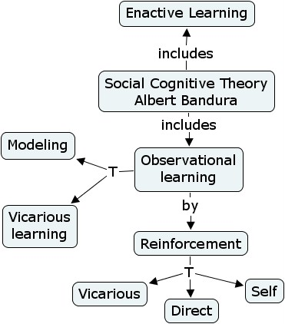
The Theory, For Example
According to a socio-constructivist perspective:
  (1) active participants in a discussion show better learning outcomes, so
  (2) social network analyses of students discussing in a forum are conducted in order to discover effective ways of supporting participatory online learning
(Seufert, et.al., 2019).
https://www.sfu.ca/~jcnesbit/EDUC220/week9/week9.html

Slide 22
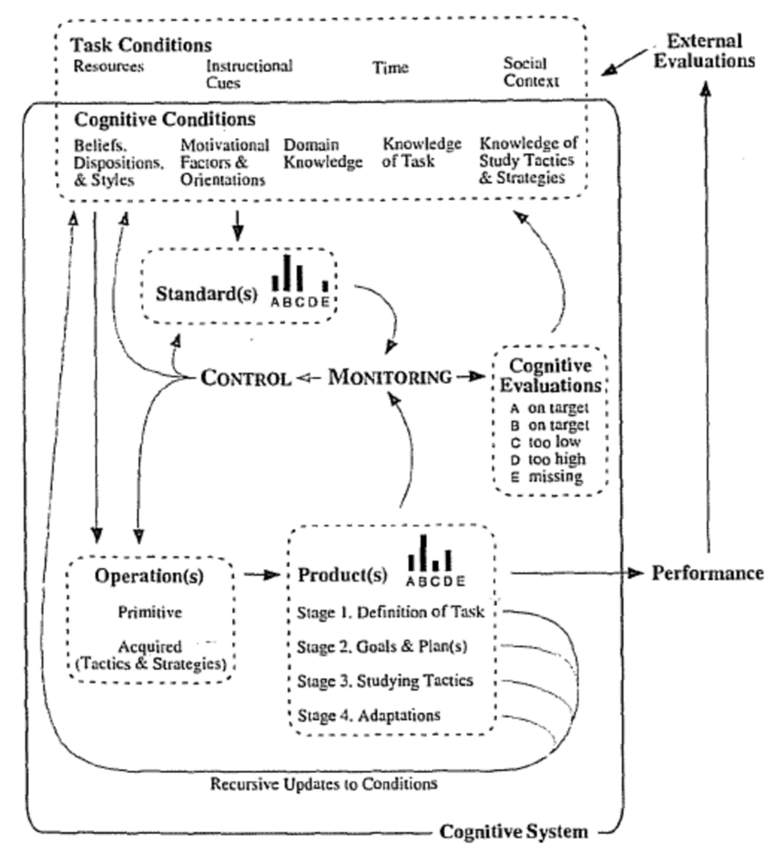
COPES Models
Conditions
Operations
Products
Evaluation
Standards
  “The model builds on conditions, operations, products, evaluation, and standards learners adopt in order to explain how they construct knowledge. In essence, learners construct knowledge by using (cognitive, digital, and physical) tools to perform operations on raw information in order to create products of learning”
  Gašević, Dawson, Siemens, 2015
Ranalli, 2012, https://www.researchgate.net/publication/323694812_Alternative_Models_of_Self-regulation_and_Implications_for_L2_Strategy_Research

Slide 23
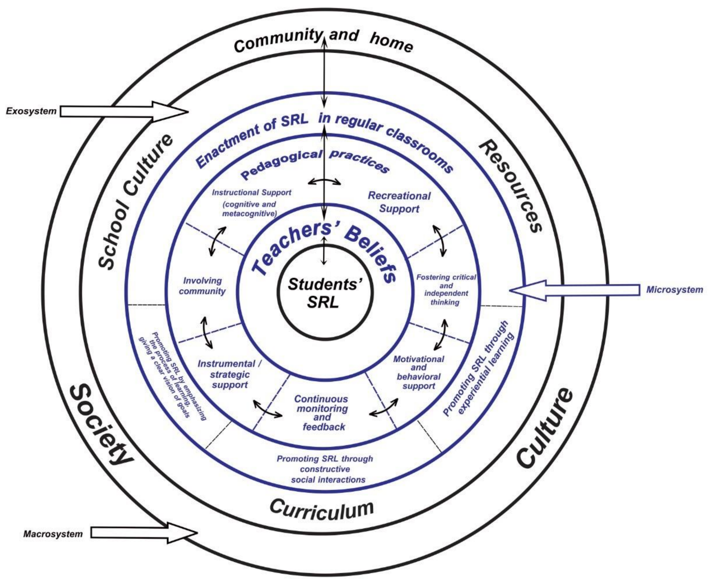
Winne’s Axioms for SRL
Learners construct knowledge
Learners are agents
Data includes randomness.
  The difference in instructional conditions
  Effects of Internal Conditions
  Effects of Learning Products and Strategy
https://www.mdpi.com/2227-7102/10/4/98/htm
Gašević, Dawson, Siemens, 2015
Winne, 2017 https://www.routledgehandbooks.com/doi/10.4324/9781315697048.ch3

Slide 24
The Conditions For Learning
Instructional conditions – instructors, instructional models and technology choices
external conditions, such as instructional design, social context, previous learning history with the use of a particular tool, and revisions in the course content
internal conditions such as achievement goal orientation, cognitive load, or epistemic beliefs are yet to be fully understood in relation with their collection and measurement with/from trace data.
Dragan Gašević, Shane Dawson, George Siemens, https://www.sfu.ca/~dgasevic/papers_shared/techtrends2015.pdf

Slide 25
Things To Consider…
qualitative research methods vs simple quantification
  “the primary emphasis in the learning analytics field has been in memory recall”
How to design effective visualizations and dashboards
  “it is essential to consider instructional, learning and sensemaking benefits for learning.”
development of learning analytics culture and policies
Dragan Gašević, Shane Dawson, George Siemens, https://www.sfu.ca/~dgasevic/papers_shared/techtrends2015.pdf

Slide 26
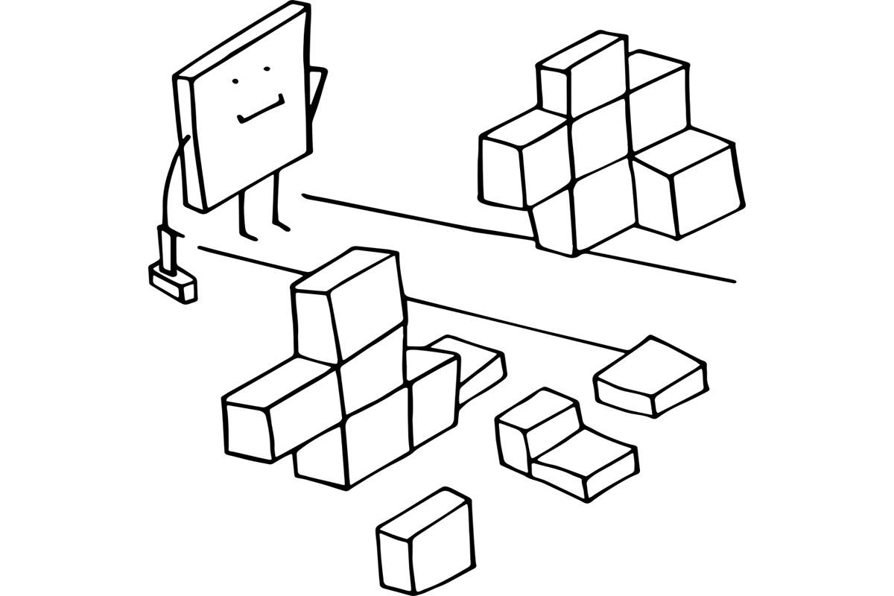
Constraints

Slide 27
Constraints - External
Privacy: Is the analysis in accordance with privacy arrangements and are the students properly informed?
Ethics: What are the dangers of abuse/misguided use of the data?
Norms: Are there legal data protection or IPR issues related to this kind of use of student data?
Time scale. Is the analysis post-hoc or just-in-time? Will students still be able to benefit from the analytics outcome?
https://iacis.org/iis/2016/3_iis_2016_236-243.pdf
https://twproject.com/blog/theory-constraints-project-management/

Slide 28
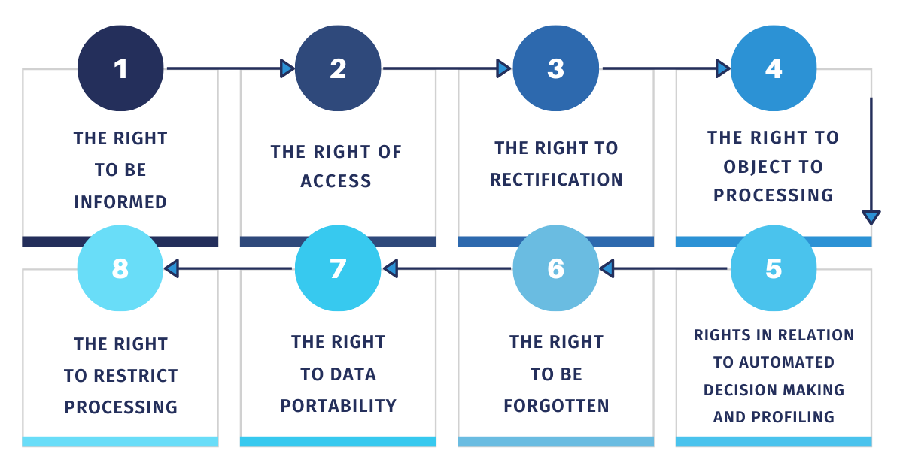
GDPR Constraints
https://dataprivacymanager.net/what-are-data-subject-rights-according-to-the-gdpr/

Slide 29
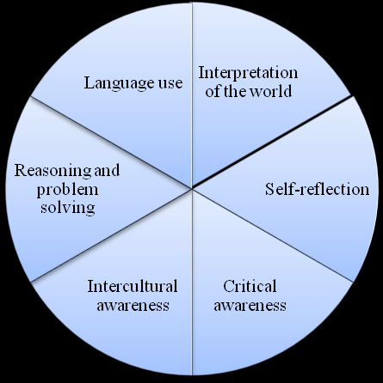
Constraints - Internal
(1) Interpretation: Do the data clients have the necessary competences to interpret and act upon the results? Do they understand the visualization or presentation of the information?
(2) Critical thinking: Do they understand which data is represented and which data is absent? How will they use this information?
https://iacis.org/iis/2016/3_iis_2016_236-243.pdf
https://www.researchgate.net/publication/319422865_The_Effectiveness_of_Teaching_Critical_Thinking_Skills_through_Literature_in_EFL_Context_A_Case_Study_in_Spain

