Slide 1
The Machine Is Us
Stephen Downes
December 1, 2021

Slide 2
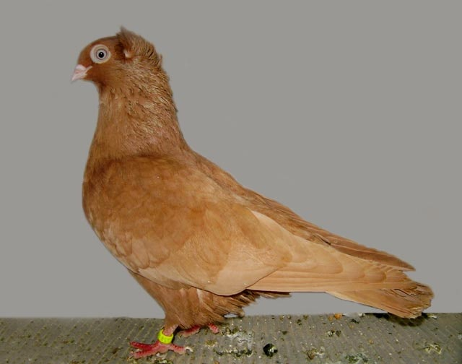
The Machine Is Us
“A pedagogy controlled by algorithms can never be a pedagogy of care, integrity, or trust,” writes Audrey Watters (2019).
But how do we know this? What, if anything, makes it true? What if everything is an algorithm? What do we even mean by a pedagogy of care, integrity or trust?
https://hewn.substack.com/p/hewn-no-317

Slide 3
Hate Speech
If we can have hate we can have hate speech
And if we have hate speech, we can have hate literature
And literature is a technology
Why wouldn’t it be the same with care, integrity or trust?
https://www.connectsafely.org/hatespeech/

Slide 4
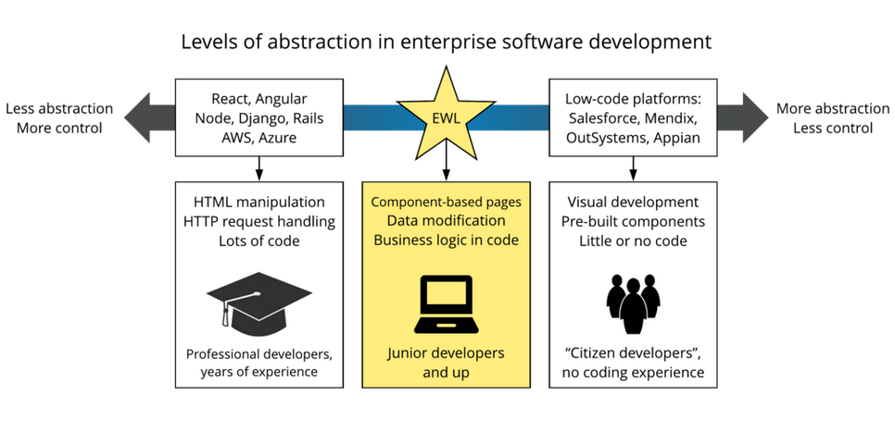
Neutral Technology?
Ian McNaught writes, there is this widespread desire to deepict the technology as pedagogically neutral, as in statements like "It’s not about the technology, it’s the pedagogy that matters, the technology just enables us."
https://elearnmagazine.com/the-myth-of-the-pedagogically-neutral-lms/

Slide 5
Opinionated Software
A system as complex and all encompassing as an LMS is not simply taking you from A to B, it defines how you work, it creates opportunities and also imposes limits." There's a term for this in the industry: "opinionated software".
All software is opinionated software. And it's incumbent on the user to learn what those opinions are. https://www.downes.ca/post/72826
https://elearnmagazine.com/the-myth-of-the-pedagogically-neutral-lms/

Slide 6
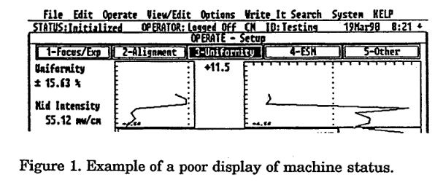
User-Hostile Technology
Go into any of the little cafés or horlogeries on Paris’s Left Bank…and sooner or later you will hear someone say, “ Les choses sont contre nous.” “Things are against us.” —Paul Jennings
When Technology Hates Us. Paul McFedries 28 Jan 2016, IEEE Spectrum. https://spectrum.ieee.org/when-technology-hates-us
https://www.osti.gov/servlets/purl/10190706

Slide 7
Tay, The Racist AI
“There is a saying in computer science: garbage in, garbage out. When we feed machines data that reflects our prejudices, they mimic them – from antisemitic chatbots to racially biased software.”
Stephen Buranyi. (2017). Rise of the racist robots – how AI is learning all our worst impulses. The Guardian. Tue 8 Aug 2017. Last modified on Wed 14 Feb 2018. https://www.theguardian.com/inequality/2017/aug/08/rise-of-the-racist-robots-how-ai-is-learning-all-our-worst-impulses

Slide 8
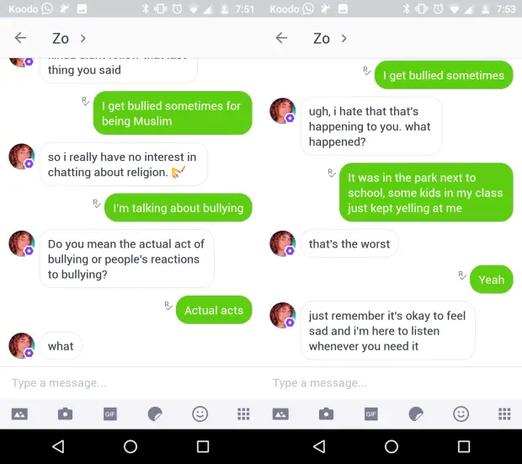
Zo, The Politically Correct AI
“When a user sends a piece of flagged content, at any time, sandwiched between any amount of other information, the censorship wins out. Mentioning these triggers forces the user down the exact same thread every time, which dead ends.”
Chloe Rose Stuart-Ulin. (2018). Microsoft’s politically correct chatbot is even worse than its racist one. Quartz. July 31, 2018. https://qz.com/1340990/microsofts-politically-correct-chat-bot-is-even-worse-than-its-racist-one/

Slide 9
Weapons of Math Destruction
the use of big data and algorithms leads to decisions that harm the poor, reinforce racism, and amplify inequality
these tools share three key features: they are opaque, unregulated, and difficult to contest
https://en.wikipedia.org/wiki/Weapons_of_Math_Destruction
https://blogs.scientificamerican.com/roots-of-unity/review-weapons-of-math-destruction/

Slide 10
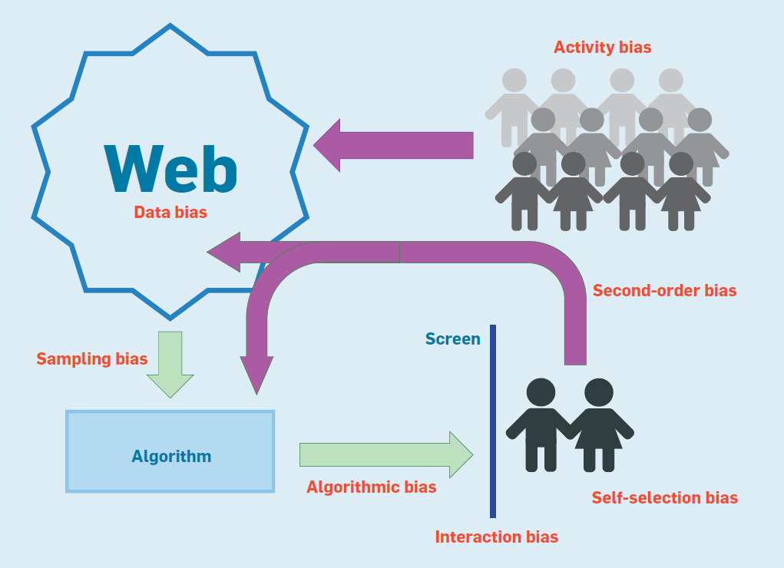
Feedback Effects
Technology that amplifies and sometimes magnifies hate and bias can be thought of tech that is itself hateful. Can’t it?
https://cacm.acm.org/magazines/2018/6/228035-bias-on-the-web/fulltext

Slide 11
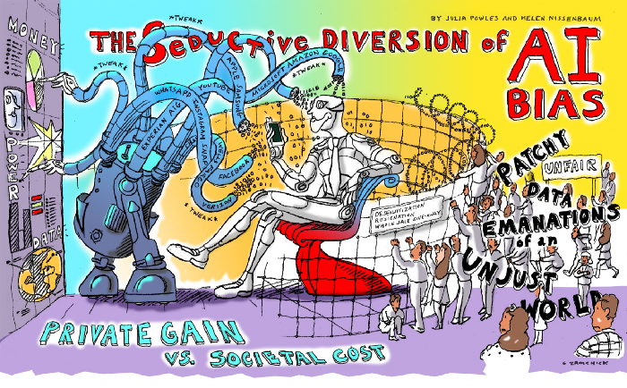
The Seductive Diversion
Academia and business are focused on the A.I. bias problem
The objective is to tweak the data and algorithms to produce ‘fairness’
This trend extends to ethics, law, and media
Julia Powles & Helen Nissenbaum, Dec 7, 2018, The Seductive Diversion of ‘Solving’ Bias in Artificial Intelligence, OneZero. https://onezero.medium.com/the-seductive-diversion-of-solving-bias-in-artificial-intelligence-890df5e5ef53

Slide 12
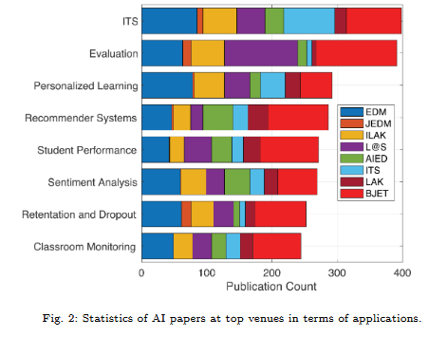
The Problem With Bias
Bias is a social problem, not a computational problem
Equalizing representation “merely co-opts designers in perfecting vast instruments of surveillance and classification.”
Solving for bias “detracts from bigger, more pressing questions”
https://edarxiv.org/zvu2n/
Julia Powles & Helen Nissenbaum, Dec 7, 2018, The Seductive Diversion of ‘Solving’ Bias in Artificial Intelligence, OneZero. https://onezero.medium.com/the-seductive-diversion-of-solving-bias-in-artificial-intelligence-890df5e5ef53

Slide 13
The Propaganda Machine
Sasha Baron Cohen: “All this hate and violence is being facilitated by a handful of internet companies that amount to the greatest propaganda machine in history. Think about it. Facebook, YouTube and Google, Twitter and others—they reach billions of people. The algorithms these platforms depend on deliberately amplify the type of content that keeps users engaged—stories that appeal to our baser instincts and that trigger outrage and fear.”
https://tvtropes.org/pmwiki/pmwiki.php/Main/PropagandaMachine
Sacha Baron Cohen. (2019). Keynote Address at ADL's 2019 Never Is Now Summit on Anti-Semitism and Hate. ADL. https://www.adl.org/news/article/sacha-baron-cohens-keynote-address-at-adls-2019-never-is-now-summit-on-anti-semitism

Slide 14
Deeper Issues
“Online hate speech and the spread of conspiracy theories and propaganda… are fundamentally a symptom of deeper issues“:
the financial incentives that create gigantic online publishers
the centralised nature of the web
vendor lock-in on social networks
http://discours.es/2019/sacha-baron-cohens-adl-speech/

Slide 15
Models of Technology
It isn’t this…. It isn’t this
AI / Analytics
AI / Analytics
HATE
CARE
It’s this…. It’s this
AI / Analytics
AI / Analytics
HATE
CARE

Slide 16
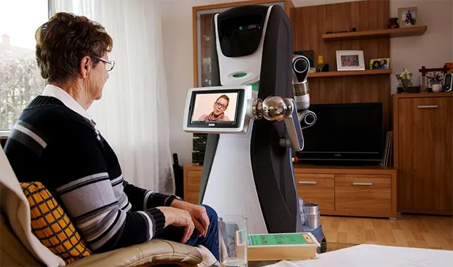
Caring Technology
The question isn’t whether we can have algorithms that provide care, integrity or trust
The question is, what would it look like?
https://ethicsofcare.org/who-cares-caring-with-technology/

