Slide 1
Caring as a Virtue
Stephen Downes
November 27, 2021

Slide 2
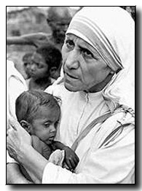
Care as a Virtue
Curzer: “a point at which three of the most fashionable recent movements in ethics (virtue ethics, medical ethics, feminist ethics) intersect.”
Thesis A: care as emotional attachment (liking, loving, etc.)
No: “Emotional attachment is incidental and destructive to the practice.”
Thesis B1: benevolence is a role virtue for HCPs
Thesis B2: benevolence disposes HCPs to perform caring acts.
Howard Curzer, 1993, is Care a Virtue for Health Care Professionals, The Journal of Medicine and Philosophy 18: 51-69,1993 https://www.researchgate.net/publication/14766358_Is_Care_a_Virtue_for_Health_Care_Professionals
https://www.catholiceducation.org/en/culture/catholic-contributions/the-virtue-of-care.html
Title image: https://www.animal-ethics.org/ethics-animals-section/ethical-theories-nonhuman-animals/virtue-ethics-care-ethics/

Slide 3
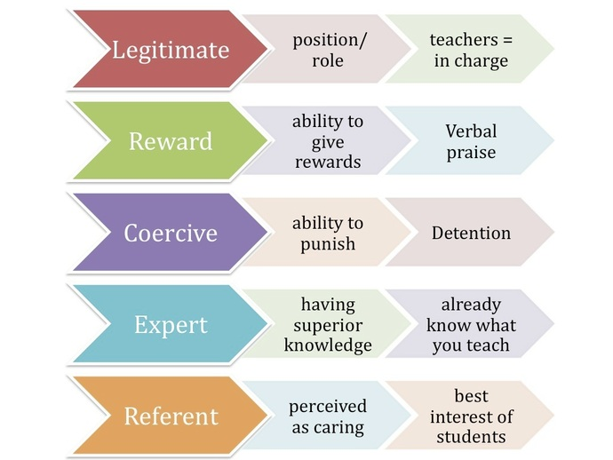
Authority
It is common in most cultures to view the teacher as an authority
Noddings:
Teachers feel a duty “to know and to use our knowledge to initiate the young into a community of knowing.”
“But the world is now so enormously complex that we cannot reasonably describe one model of an educated person.”
Carers dedicted to their own view of what the cared-for should be and do lack integrity
Savage & Savage (2010) suggest that "...developing productive leadership in the classroom is based on the establishment of expert and referent authority" (p. 31).
http://classroommanagementdiscipline.weebly.com/authorityleadership.html

Slide 4
Empathy
Some writers interested in care ethics put great emphasis on empathy (Hoffman, 2000; Slote, 2007)
“Martin Hoffman, ‘empathy is the cognitive awareness of another person’s internal states, that is, his thoughts, feelings, perceptions, and intentions’ and ‘the vicarious affective response to another person’
Empathy may be related to the motivational effect of care
But it isn’t a substitute for an expressed response; “the response of the cared-for completes the caring relation. Without it, there is no caring relation - no matter how hard the carer has tried to care.”
https://ieag.org.nz/assets/Uploads/Noddings-2012-1.pdf

Slide 5
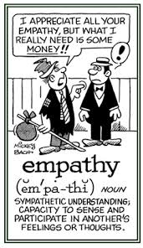
Empathy as Sensation
“This paper serves not only to show that empathy (a notion at the heart of the phenomenology of sociality) takes place online but opens the door to a rich array of phenomenological investigations in relation to our experiences online.” https://philpapers.org/archive/OSLTEO.pdf
Cognitive vs. Emotional Empathy, Jodi Clarke https://www.verywellmind.com/cognitive-and-emotional-empathy-4582389

Slide 6
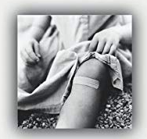
Caring Capacities
Noddings: “people have various capacities for caring - that is, for entering into caring relations as well as for attending to objects and ideas.” (p.18)
Factors that curtail our ability to care:
the social construction of caring as feminine and thus less worthwhile;
the churn of clients through the institution
associated responsibilities caused by digital technology
work-related stress can activate implicit biases, which unconsciously distance personnel from members of stigmatized groups and contribute to health care disparities.
https://www.amazon.ca/Capacity-Care-Gender-Ethical-Subjectivity/dp/0415399688
http://mehrmohammadi.ir/wp-content/uploads/2020/09/The-Challenge-to-Care-in-School-Nel-Noddings.pdf
Brooke A. Cunningham, 2016, Our capacity to care, https://pubmed.ncbi.nlm.nih.gov/29195522/

Slide 7
Virtuous Dispositions
Tronto identifies four sub-elements of care that can be understood simultaneously as stages, virtuous dispositions, or goals. These sub-elements are:
attentiveness, a proclivity to become aware of need;
responsibility, a willingness to respond and take care of need;
competence, the skill of providing good and successful care; and
responsiveness, consideration of the position of others as they see it and recognition of the potential for abuse in care (1994, 126-136).
Joan C. Tronto. An Ethic of Care. In Ethics in Community-Based Elder Care by Martha Holstein
https://www.iep.utm.edu/care-eth/ -- https://books.google.com.br/books?hl=en&lr=&id=wYBLxZcU8zYC&oi=fnd&pg=PA60&dq=tronto+care+ethics&ots=8m-5tOWTIe&sig=z6rRbR-63R-XXXVFHa6ISHQC6Gw#v=onepage&q=tronto%20care%20ethics&f=false

Slide 8
Unequal Relationships
Sarah Lucia Hoagland argues that the relationships in question, such as parenting and teaching, are ideally relationships where caring is a transitory thing designed to foster the independence of the cared-for, and so end the unequal caring relationship.
Unequal relationships, she writes, are ethically problematic, and so a poor model for an ethical theory. Hoagland argues that on Noddings' account of ethical caring, the one-caring is placed in the role of the giver and the cared-for in the role of the taker. The one-caring is dominant, choosing what is good for the cared-for, but gives without receiving caring in return. The cared-for is put in the position of being a dependent
https://en.wikipedia.org/wiki/Nel_Noddings

