Slide 1
Consequentalism
Stephen Downes
November 13, 2021

Slide 2
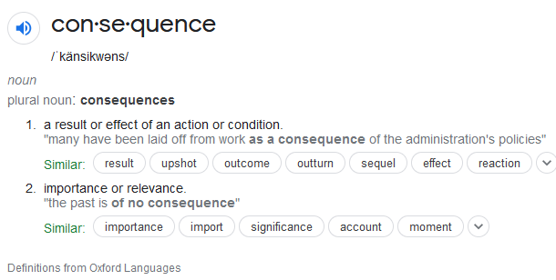
Consequentalism
Title image: https://benjaminspall.com/consequentialism/
Consequentialism, a.k.a. teleological ethics, is ethics with the end outcome in mind.
https://www.britannica.com/topic/teleological-ethics

Slide 3
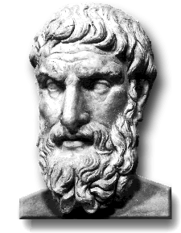
Epicurus: The Pleasure Principle
“a view of the goal of human life (happiness, resulting from absence of physical pain and mental disturbance)
“an empiricist theory of knowledge (sensations, together with the perception of pleasure and pain, are infallible criteria)”
https://plato.stanford.edu/entries/epicurus/
https://en.wikipedia.org/wiki/Epicurus
https://archive.org/details/epicureanism00walluoft/page/n21/mode/2up

Slide 4
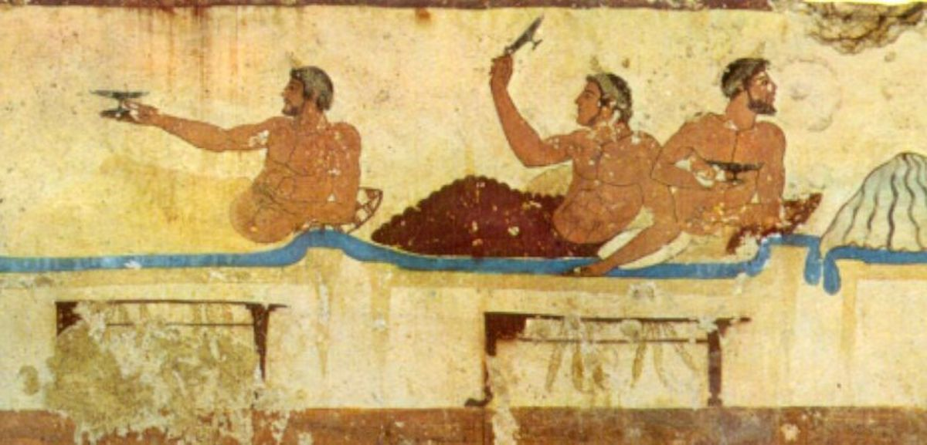
Hedonism
“Epicurus was a hedonist, meaning he taught that what is pleasurable is morally good and what is painful is morally evil. He idiosyncratically defined ‘pleasure’ as the absence of suffering and taught that all humans should seek to attain the state of ataraxia, meaning "untroubledness", a state in which the person is completely free from all pain or suffering.” - Wikipedia
https://owlcation.com/humanities/Epicurean-Hedonism-vs-Modern-Hedonism
https://en.wikipedia.org/wiki/Cyrenaics - a sensual hedonist Greek school of philosophy founded in the 4th century BCE by Aristippus of Cyrene,

Slide 5
Dukkha
The Pali word dukkha is most commonly translated to English as “suffering.”
We living beings are trapped in the cycle of existence known as samsara
In samsara, we experience unbearable suffering because of the tight grip of our grasping at self.
https://www.lionsroar.com/what-is-suffering-10-buddhist-teachers-weigh-in/

Slide 6
The Range of Suffering
anxiety vexation pain desperation sorrow sadness suffering misery agony anguish
unsettledness
irritation
impatience
annoyance
frustration
disappointment
dissatisfaction
aggravation
tension
stress

Slide 7
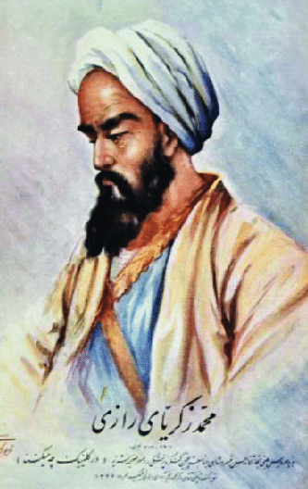
Moderation
Abu Bakr al-Razi on pleasure:
moderation is ‘the way to have the most pleasure: going too far with pleasures turns out to be more painful in the long run.’ -vs-
pleasure is not the good to be sought in itself - pleasure can be had only as the result of a process of removing a harmful state.
https://plato.stanford.edu/entries/abu-bakr-al-razi/#Ethi
https://philarchive.org/archive/DRUTEO-3

Slide 8
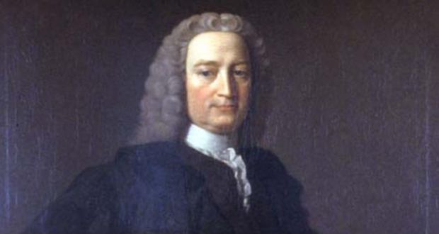
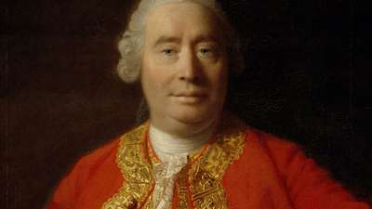
Happiness
Francis Hutcheson: “that action is best, which procures the greatest happiness for the greatest numbers.”
David Hume: introduces the term ‘utility’ to describe the pleasing consequences of actions as they impact people. (Pojman & Fieser, 2012, 103)
https://www.irishtimes.com/culture/the-moral-sense-of-down-man-francis-hutcheson-1.1889280
https://www.researchgate.net/post/Humes_Utility_Of_what_does_it_consist

Slide 9
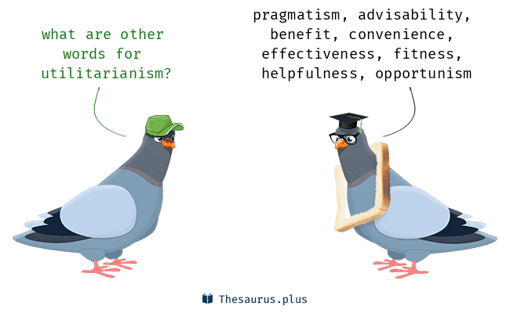
Utilitarianism
The consequentialist principle: the rightness or wrongness of an act is determined by the goodness or badness of the results
The utility principle: the only thing that is good in itself is the specific state of pleasure, happiness or welfare (Pojman & Fieser, 2012, 103)

Slide 10
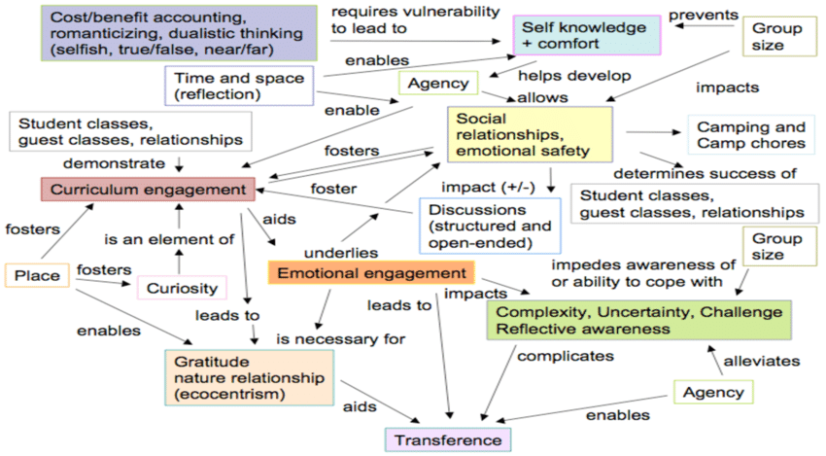
Calculating Utility
https://www.researchgate.net/publication/277558381_FIELD_PHILOSOPHY_EXPERIENCE_RELATIONSHIPS_AND_ENVIRONMENTAL_ETHICS_IN_HIGHER_EDUCATION_dissertation
How do we calculate the many possible causes of pleasure and pain?

Slide 11
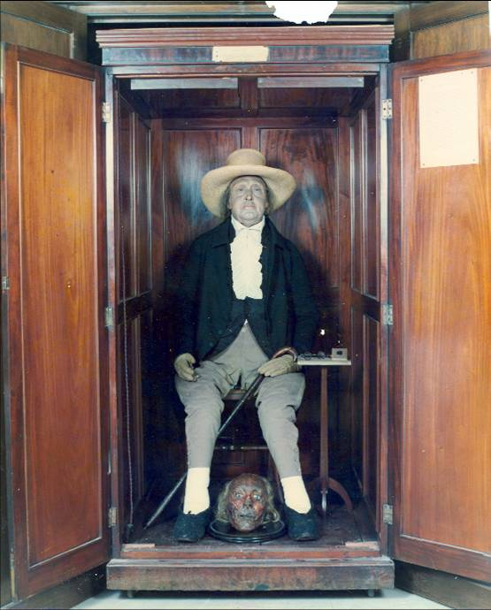
Bentham: The Felicific calculus
A.k.a. the utility calculus or the hedonic calculus.
Intensity: How strong is the pleasure?
Duration: How long will the pleasure last?
Certainty or uncertainty: How likely or unlikely is it that the pleasure will occur?
Propinquity or remoteness: How soon will the pleasure occur?
Fecundity: The probability that the action will be followed by sensations of the same kind.
Purity: The probability that it will not be followed by sensations of the opposite kind.
Extent: How many people will be affected?
https://en.wikipedia.org/wiki/Felicific_calculus

Slide 12
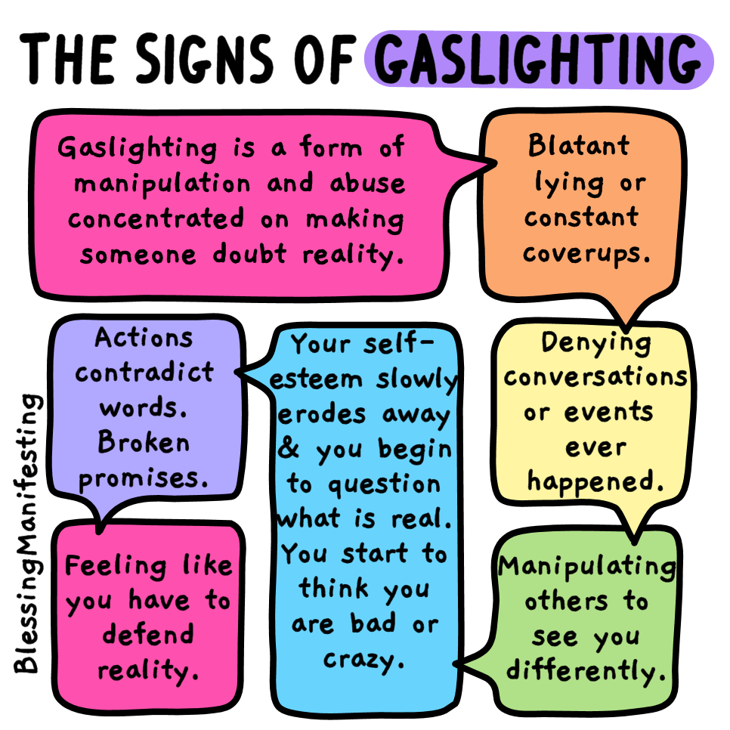
Machiavellianism
“Machiavellians are characterized by manipulation and exploitation of others, with a mocking disregard for morality and a focus on self-interest and deception.”
“But Machiavelli’s arguments have also been seen as recognition of the realities of political life.”
https://contemporary-wellness.com/how-to-tell-if-youre-dating-a-machiavellian/
https://www.ckju.net/en/dossier/machiavellianism-what-it-how-recognize-and-cope-machiavellians
https://www.sciencedirect.com/topics/psychology/machiavellianism

Slide 13
Higher and Lower Pleasures
“It is better to be a human being dissatisfied than a pig satisfied; better to be Socrates dissatisfied than a fool satisfied.” – John Stuart Mill
https://www.shellypjohnson.com/how-to-pursue-a-good-life-by-maximizing-happiness-and-minimizing-pain/

Slide 14
On Liberty
John Stuart Mill’s On Liberty: “The only freedom which deserves the name, is that of pursuing our own good in our own way, so long as we do not attempt to deprive others of theirs, or impede their efforts to obtain it.” (p. 23)
https://www.gutenberg.org/files/34901/34901-h/34901-h.htm

Slide 15
Egoism
Psychological Egoism – the motive for all of our actions is self-interest
Ethical Egoism – the motivation for all of our action should be self-interest
https://www.thoughtco.com/what-is-ethical-egoism-3573630

Slide 16
Selfishness and Greed
Egoism allows for selfishness and greed to be elevated to ethical principles.
https://www.theguardian.com/books/2017/apr/10/new-age-ayn-rand-conquered-trump-white-house-silicon-valley

Slide 17
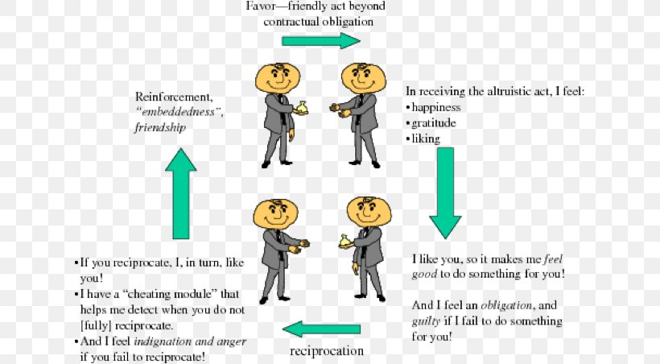
Enlightened Self-Interest
E.g. In 1971, Robert Trivers coined the term 'reciprocal altruism' to describe a process that favors costly cooperation among reciprocating partners.
https://www.cell.com/current-biology/pdf/S0960-9822(13)00354-0.pdf

Slide 18
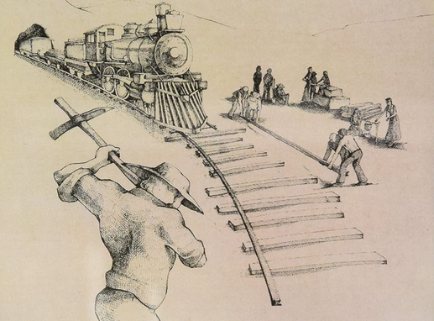
Serving Others
The funny thing about time is that if you spend it on yourself it will always feel like a waste of time.
It's when we are doing things for others that our use of our time seems meaningful.
https://en.wikipedia.org/wiki/Gotta_Serve_Somebody

Slide 19
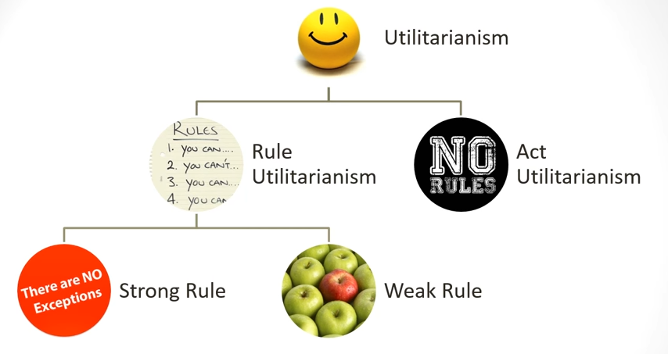
Rule Utilitarianism
The idea that the happiness principle can be expressed as rules instead of calculated on an act-by-act basis.
https://www.youtube.com/watch?v=GrZp12isYb4

Slide 20
Moral Conservatism
The idea that there are some rules that it would always be wrong to break, no matter what the particular consequences
(It being a matter of a ‘higher good’)
https://www.washingtonpost.com/resizer/_5HCdr5arfCfCuSahK7CMCRH4iQ=/arc-anglerfish-washpost-prod-washpost/public/WYD4GOA6TMI6LLVZUQI2QTE5KU.jpg

Slide 21
Responsibility
The idea that individuals and (maybe) corporations are ethically accountable for the consequences of their actions
Of relevance is whether the consequences were predictable and whether the party intended the outcome (or displayed indifference to a bad outcome)

Slide 22
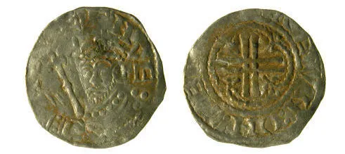
The One Versus the Many
Is it better to give one person a million dollars or to give a million people one dollar?
Is it worth the sacrifice on one life to save five (c.f. the Trolley problem)? Is it better to hang an innocent man to avoid freeing five?
Is the hedon a common currency – e.g., can we trade one life to slightly improve the happiness of everyone else?
Are there things that cannot be expressed as a value?
https://hedonblog.co.uk/2012/07/30/hedon-silver-pennies/

Slide 23
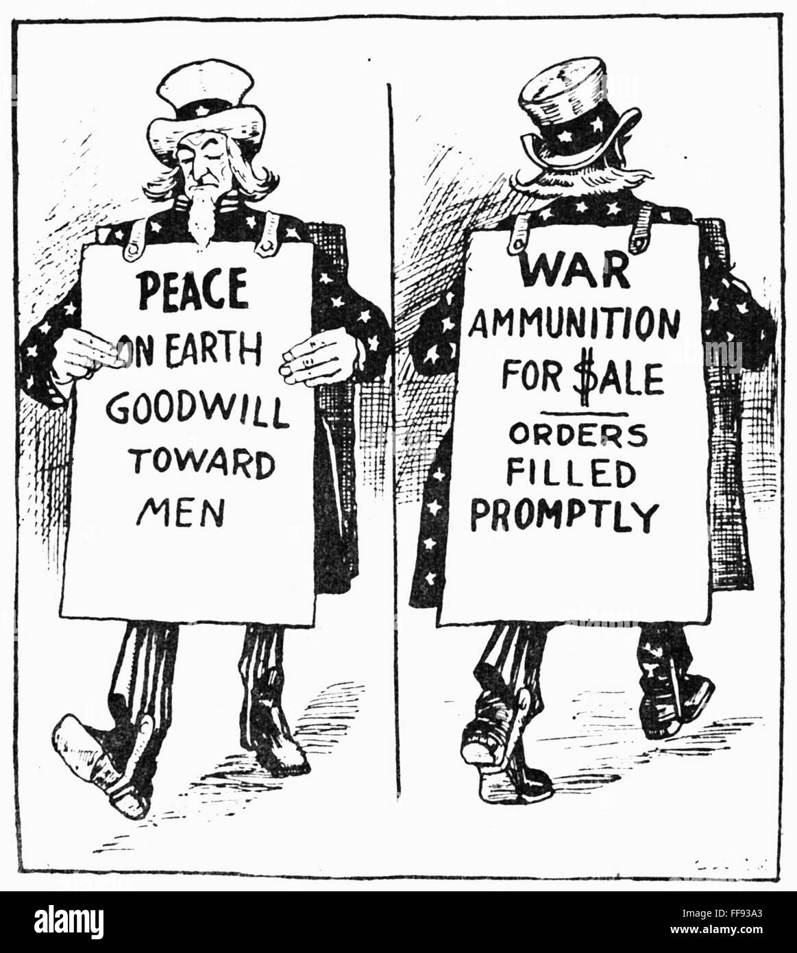
Conflicting Calculations
The core question here is whether utilitarianism is measuring an actual objective standard, or whether it just depends on your point of view:
If two rules conflict, how do we decide?
If two calculations of happiness conflict, how do we decide?

Slide 24
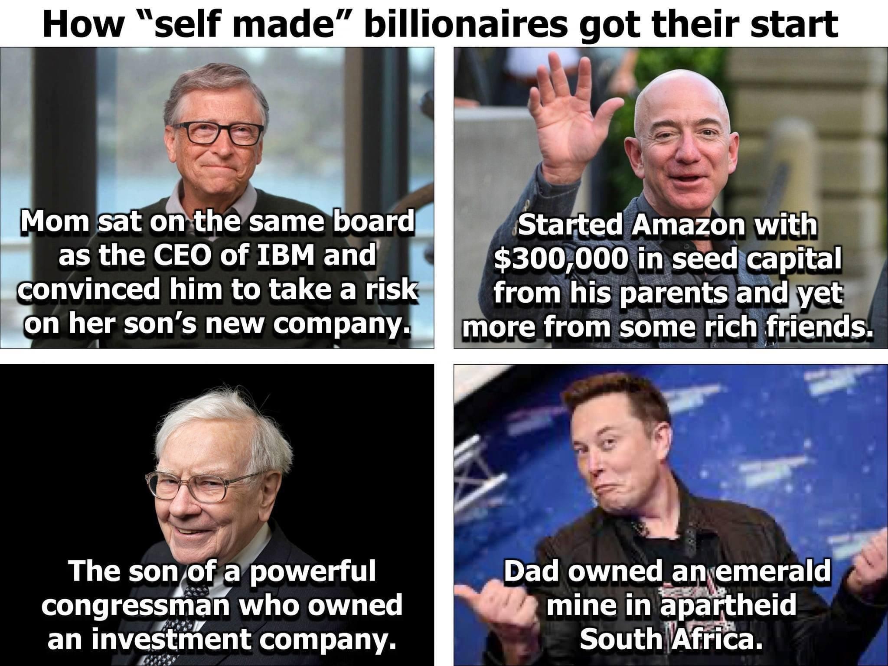
Moral Luck
One person drives drunk and kills someone and spends several years in jail
Another also drives drunk but does not kill anyone and spends no time in jail
The difference between them is just a matter of luck
So whatever utilitarianism is, it’s not ethics
https://imgur.com/gallery/KNETtHH

