Slide 1

Values
Stephen Downes
November 4, 2021

Slide 2
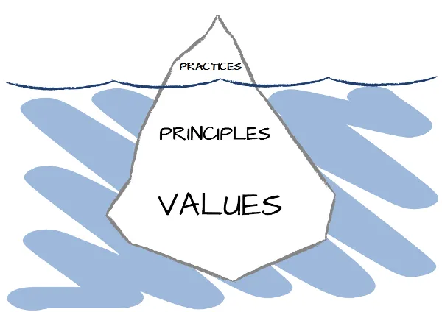

Values and Principles
Codes are divided by:
  Values – general moral values, such as ‘honesty’ and ‘trustworthiness’
  Principles – the ethical conditions or behaviors we expect
    “An ethical principle is a statement concerning the conduct or state of being that is required for the fulfillment of a value; it explicitly links a value with a general mode of action.” (Cooper, 1998)
https://www.infoq.com/articles/change-practices-principles-values/

Slide 3
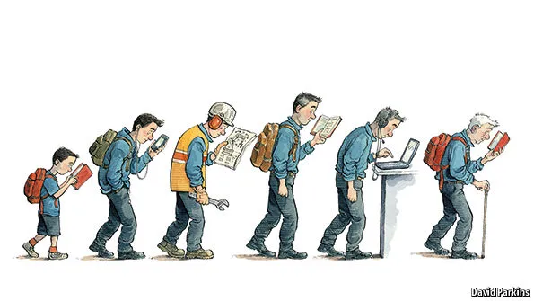
Pursuit of Knowledge
“The first responsibility of university teachers is the pursuit and dissemination of knowledge and understanding through teaching and research.” (SFU, 1992).
“…the supreme importance of the pursuit of truth, devotion to excellence, and the nurture of the democratic principles.” (NEA, 1975)
https://katherinereilly.blog/2018/03/28/lifelong-learning-the-ongoing-pursuit-of-knowledge/

Slide 4
Autonomy and Individual Value
Believing in the worth and dignity of each human being
  Kantian idea of people as ‘ends’, not ‘means’
  also, cf. Singer, worth and dignity of animals, the environment
Or, autonomy embracing the idea of ‘informed consent’
  requires disclosure of information, respect for decision-making, and provision of advice
Or, two basic ethical convictions:
  first, that individuals should be treated as autonomous agents, and
  second, that persons with diminished autonomy are entitled to protection.” (DHEW, 1978:4)

Slide 5
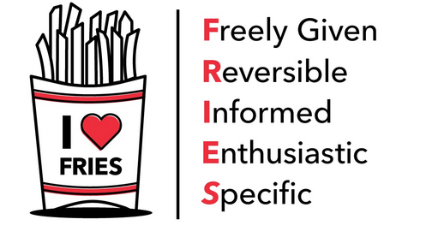
Consent
The Nuremberg Code and marketing research may stand at opposite poles of an ethical question, however, they are reflective of a society as a whole that holds consent as sacrosanct on one hand and makes legal End User Licensing Agreements (EULA) on the other hand.
https://h5pstudio.ecampusontario.ca/content/23057

Slide 6
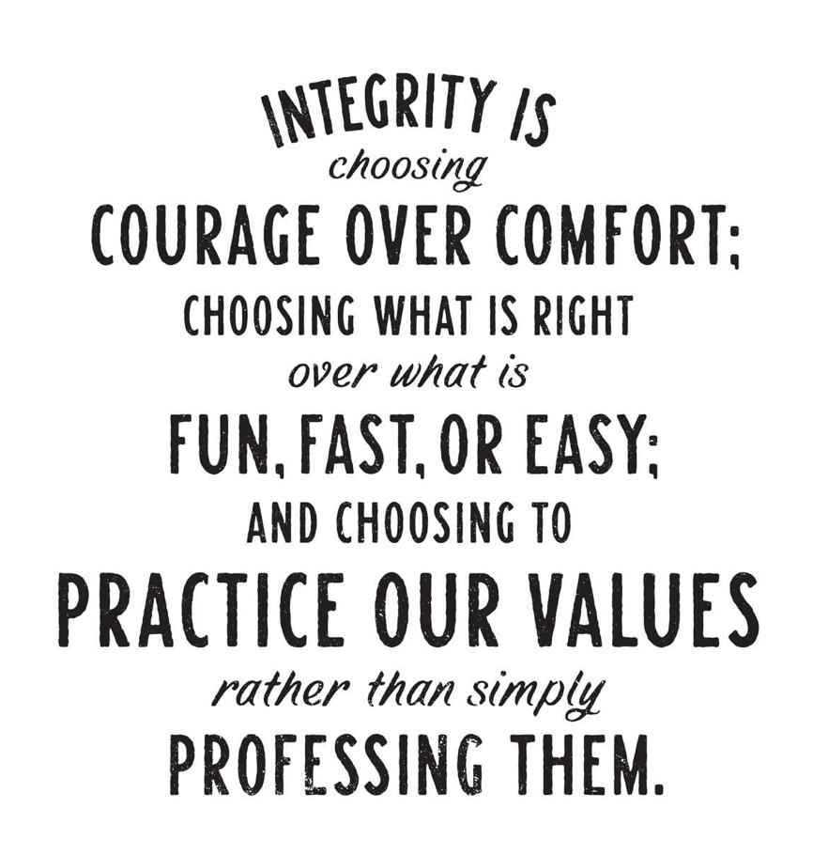
Intregrity
Different codes stress different aspects of integrity:
  honesty, trust, fairness and respect. (EUI, 2019)
  accuracy, honesty, objectivity, openness, disclosure, and avoidance of conflict of interest (CPA, 2017)
  honest representation of one’s own credentials, fulfilment of contracts, and accountability for expenses” (Guyana, 2017)
https://www.quora.com/What-does-integrity-mean-for-most-people

Slide 7

Confidentiality
Confidentiality is often presented as a virtue in and of itself, perhaps constitutive of integrity.
Confidentiality, expressed as privacy, is a core principle for data and information services and codes regulating those.

Slide 8

Care
“Compassion, acceptance, interest and insight for developing students' potential” (OCT, 2020)
“Treating all children with love and affection irrespective of their school performance and achievement level” (NCERT, 2010).
legalist interpretation of ‘duty of care’, for example, that researchers must “prioritize data subject privacy above business objectives

Slide 9

Competence and Authority
Competence or authority to practice in the profession as core values or principles (CFA, 2019; IEEE, 2020: 7.8; IUPSYS, 2008; etc.).
  expectation to perform in a competent manner
  requirement to remain within their domain of competence
  obligation to ensure that unqualified people do not practice the profession
Sometimes what counts as competence is spelled out in the code
  use of robust data models in data research
  should be sound and free from bias
https://righttoinformation.wiki/explanations/competent-authority

Slide 10
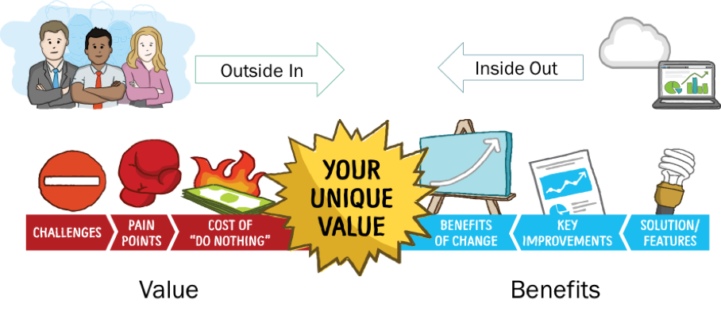
Value and Benefit
Previously we represented ‘the good that can be done’ as aspirational; here we view the same principle as a limit.
  “obligation to distinguish between remedies that represent the careful consensus of highly trained experts and snake oil” (Kennedy, et.al., 2002).
  “show clear user need and public beneﬁt” (Drew, 2016).
  “shared broadly, to benefit all of humanity” (Asilomar, 2017).
  “specify purposes of data gathering in advance” (Barcelona Principles, 2010)
http://blog.alinean.com/2017/04/gartner-importance-of-value-not-just.html

Slide 11

Non-Maleficence (Don’t Be Evil)
Adaptation of the principle of “do no harm”
Necessary because harm is unavoidable in many circumstances
  “avoiding anything which is unnecessarily or unjustifiably harmful…” Beauchamp & Childress (1992)
  consideration of what the subject considers to be harm (Englehardt, 1993)
  Non-maleficence in research and data science includes being minimally intrusive (Drew, 2016)
https://www.karger.com/Article/FullText/509119

Slide 12
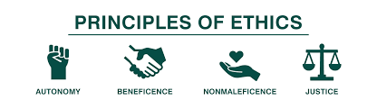
Beneficence
more than non-maleficence and distinct from value and benefit.
“the principle of acting with the best interest of the other in mind” (Aldcroft, 2012).
                Should ‘the common good’ is included in the principle of beneficence? Should AI promote social justice, or merely be developed consistently with the principles of social justice?
Tom Beauchamp and Jim Childress: https://www.nwabr.org/sites/default/files/Principles.pdf

Slide 13

Respect
Examples:
  acting toward students with respect and dignity (BCTF, 2020)
  “respect for people” (TBS, 2011)
  “mutual respect” (Folan, 2020)
  “respect for the composite culture of India among students” (NCERT, 2010)
  “respect for the rights and dignity of learners” (Stevens & Silbey, 2014)
  promoting “human dignity and flourishing” (AI4All)
https://www.ccl.org/articles/leading-effectively-articles/the-power-of-respect/

Slide 14

Democracy
May mean respect for the idea of rule by the people, respect for the results of democratic choice (as, say, found in public service ethics; TBS,2011:1.1-1.2),
May also mean respect for democratic values, such as justice and non-discrimination.
https://www.un.org/en/observances/democracy-day

Slide 15
Justice
Ever since John Rawls’s influential A Theory of Justice (Revised, 1999) the concepts of ‘justice’ and ‘fairness’ have been linked in popular discourse, according to the principle ‘justice as fairness’.
Justice, sometimes coined as ‘natural justice’ (CPA, 2017:11), can also be depicted in terms of rights (Stevens & Silbey, 2014; Asilomar, 2017; Access Now, 2018).
Justice is also expressed as an endorsement of diversity and prohibition of discrimination (Sullivan-Marx, 2020; Brandom, 2018; CPA, 2017:11; BACB, 2014; etc.)
Can be expanded to include redress for current or past wrongs, or to prevent future wrongs (Brandom, 2018).

Slide 16
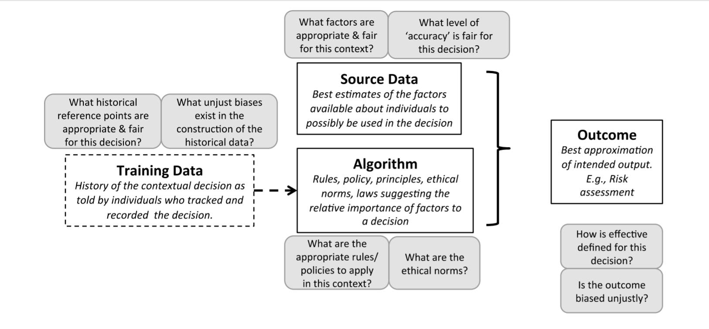
Fairness
https://uxdesign.cc/ethical-dilemmas-of-ai-fairness-transparency-human-machine-collaboration-trust-accountability-1fe9fc0ffff3

Slide 17
Accountability and Explicability
The principles of accountability and explicability arise differently in computing and AI codes than it does in other ethical codes.
  In the case of academic and medical research, accountability is typically delegated to a process undertaken by a research ethics board (REB).
  In other disciplines, a range of additional processes describe practices such as predictability, auditing and review (Raden, 2019: 9).
  “Explicability, understood as incorporating both intelligibility and accountability” where we should be able to obtain “a factual, direct, and clear explanation of the decision-making process” (Floridi et al. 2018)
  “Meaningful human control” Robbins (2019)

Slide 18
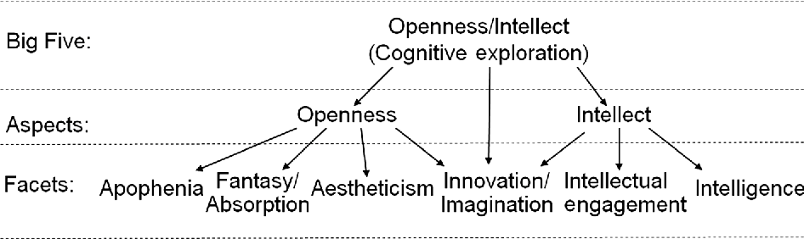
Openness
Many of the codes of ethics, especially those dedicated to research, express openness as a core value, though often with conditions attached.
  Four Freedoms: Read, Reuse, Modify, Share
  FAIR: Findability, Accessibility, Interoperability, and Reusability
  Openness understood as open access (e.g. open data)
https://www.cambridge.org/core/books/abs/cambridge-handbook-of-creativity-and-personality-research/opennessintellect/5F06D70F0FE4A53C2530522727762A49

Slide 19
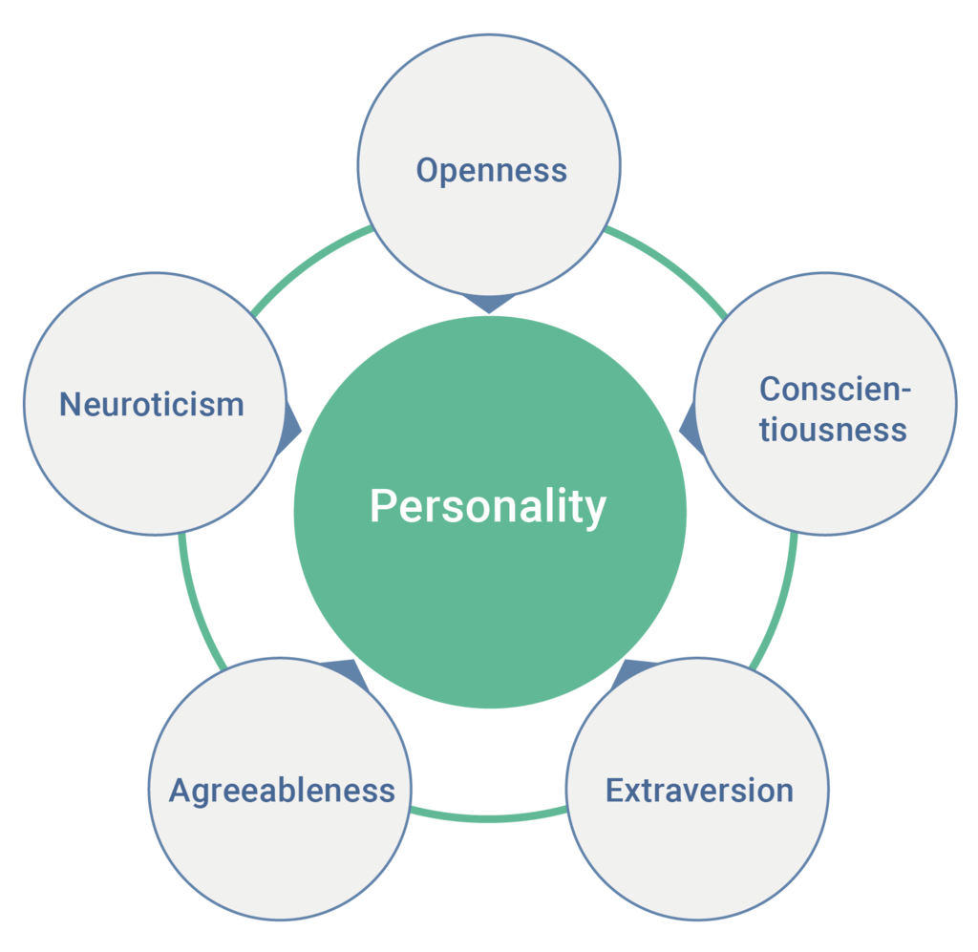
Personality Traits
extraversion (outgoing/energetic vs. solitary/reserved)
agreeableness (friendly/compassionate vs. critical/rational)
openness to experience (inventive/curious vs. consistent/cautious)
conscientiousness (efficient/organized vs. extravagant/careless)
neuroticism (sensitive/nervous vs. resilient/confident)
https://en.wikipedia.org/wiki/Big_Five_personality_traits
Digman: https://www.annualreviews.org/doi/10.1146/annurev.ps.41.020190.002221

Slide 20

Common Cause / Solidarity
Many codes of ethics also explicitly endorse an advocacy role for professionals to promote the values stated in the code.
The codes also express advocacy for a shared vision “to identify the values, knowledge and skills that are distinctive” to the profession” (OCT, 2016)
https://www.jurist.org/commentary/2020/03/louis-beres-illness-as-unifier/

