Slide 1
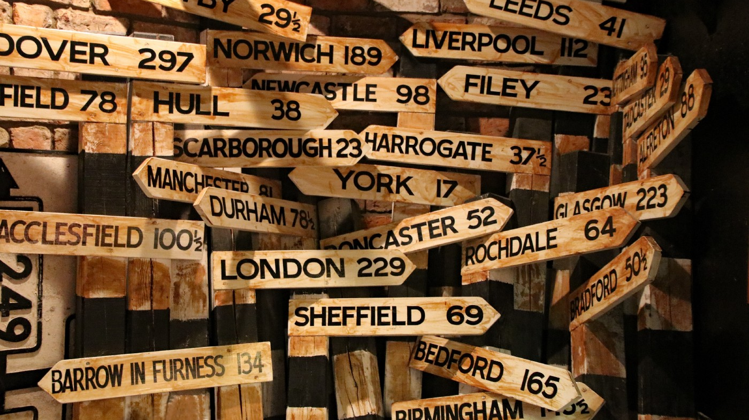
Ethical Codes and Ethical Issues
Stephen Downes
November 4, 2021

Slide 2
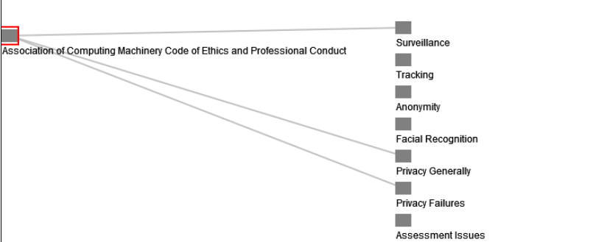
Ethical Codes and Ethical Issues
In this section we examine the ethical issues being addressed by codes of conduct. Most often these are not stated explicitly, but must be inferred from the sorts of behaviours or outcomes being expressly discussed.
https://ethics.mooc.ca/code/3

Slide 3
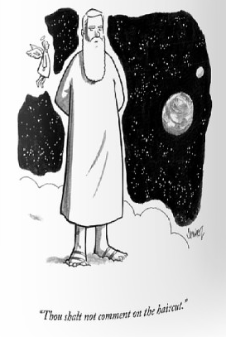
The Good That Can Be Done
As opposed to ‘thou shalt not’, many codes reference the good
Example: UK data Ethics code “intention to “maximise the value of data whilst also setting the highest standards for transparency and accountability when building or buying new data technology” (Gov.UK, 2018).
Example: Sorbonne Declaration (2020) points to “the benefit of society and economic development” that accrues as a research of data research.
Example: Open University, for example, asserts that the purpose of collecting data should be “to identify ways of effectively supporting students to achieve their declared study goals” (OU, 2014:4.2.2).

Slide 4
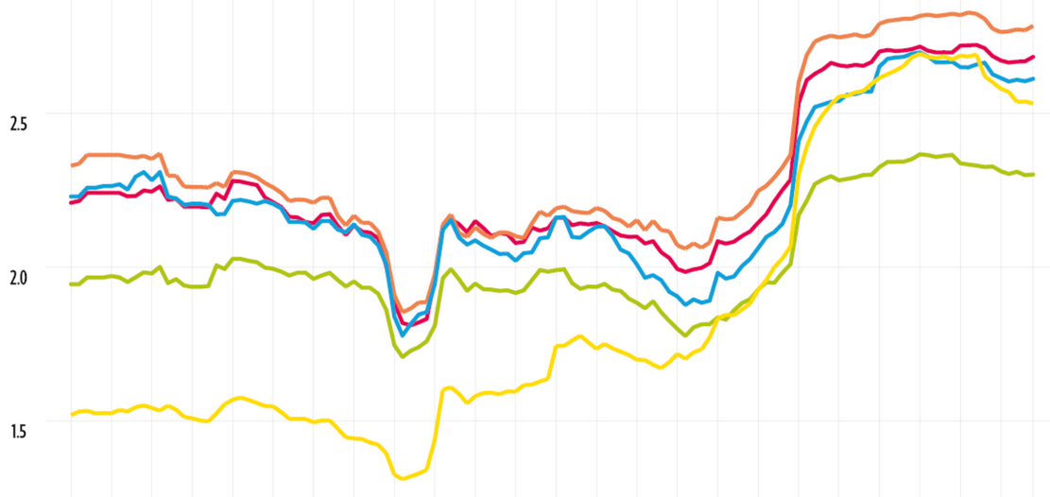
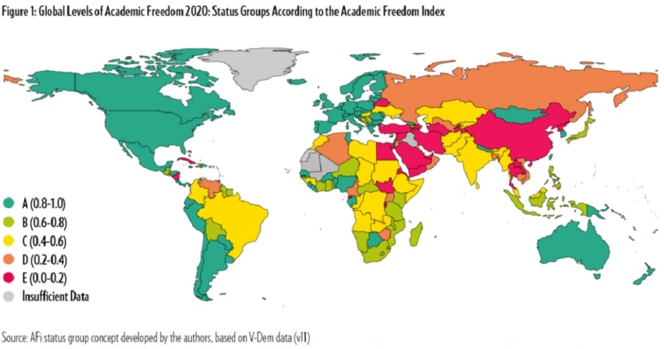
Academic or Professional Freedom
https://www.scholarsatrisk.org/resources/free-universities-putting-the-academic-freedom-index-into-action/
https://www.ei-ie.org/en/item/24856
Surfaces frequently
Not merely a ‘good’, but an obligation
Not limited to academics
Includes doctors, journalists, etc.

Slide 5
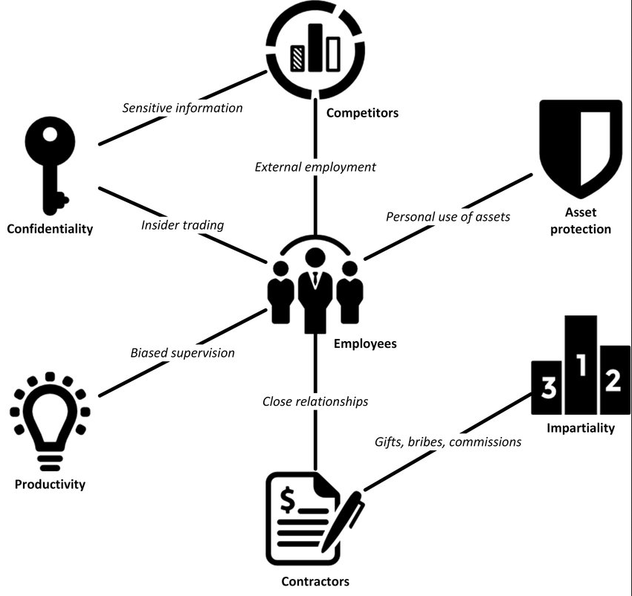
Conflict of Interest
The idea that a person would use their position to personally benefit from their position of privilege or responsibility, whether directly or through the offer of gifts or benefits, is expressly prohibited by many (but by no mean all) codes of ethics (CFA, 2019; IEEE, 2020: 7.8; SFU, 1992; CPA, 2017).
https://www.researchgate.net/publication/322291829_Conflicts_of_interest_in_business_A_review_of_the_concept

Slide 6
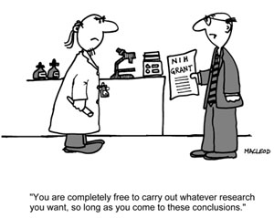
Conflict of Interest
Other codes focus on integrity. We see this in professions like journalism, where “professional integrity is the cornerstone of a journalist’s credibility” (SPJ, 1996) and journalists are urged “to remain independent (and therefore avoid conflict of interest), and to be accountable” (SPJ, 2014).
Question: what counts as a benefit?
https://sites.wp.odu.edu/research-integrity/conflicts-of-interest/

Slide 7
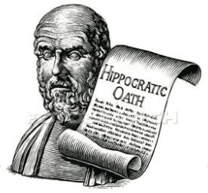
Harm
Many codes stress the need to ‘do no harm’
Often, the nature of harm is loosely defined:
Harm not limited to clients, but ‘downstream’ harm also considered
Discrimination and human rights violations are often cited as sources of harm
Some codes describe what will not be considered as harm
Risk vs. Benefit
https://www.samatters.com/first-no-harm/

Slide 8
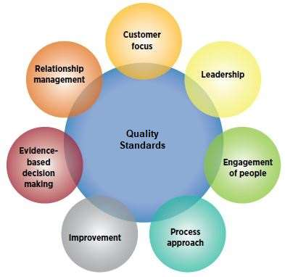
Quality and Standards
Sometimes defined in terms of competence – ‘stewardship and excellence’
Sometimes defined in terms of qualifications to prevent ‘unauthorized practice’
Sometimes in terms of exemplary behaviours such as research integrity, scientific rigor and recognition of sources.
https://asq.org/quality-resources/learn-about-standards

Slide 9
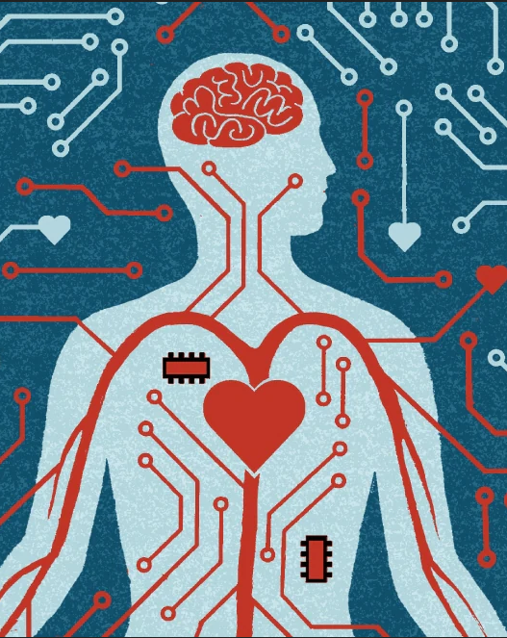
What Are The Limits?
Some ethical codes seek to address the limits of what can be done ethically.
IBM to cease work in general facial recognition technology, for example (Krishna, 2020)
Standard “to create not undirected intelligence, but beneficial intelligence” (Asilomar, 2017).
Many individual researchers refuse to work on military or intelligence applications (Shane & Wakabayashi, 2018).
Research Ethics Boards (REB) often require scientific merit and research need.

Slide 10
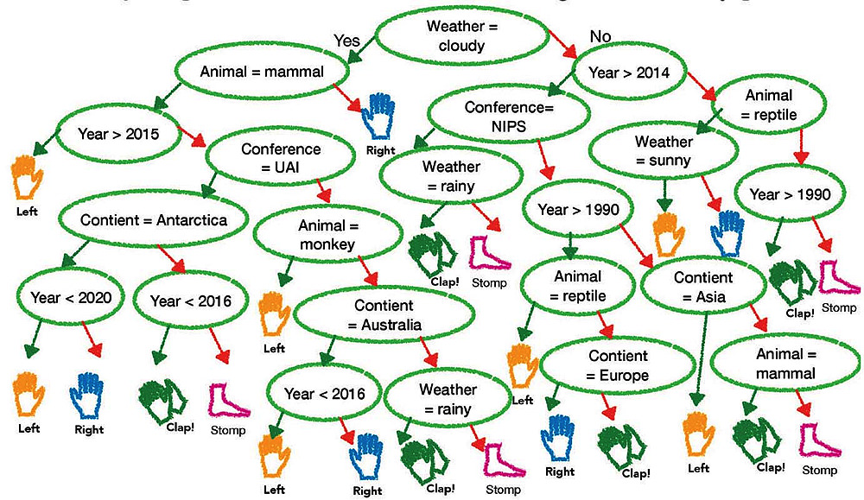
Is This Enough?
The previous section addressed ethical issues being addressed by codes of conduct. It was, in a sense, addressing the purpose of the code qua code of ethics, that is, it sought to identify the questions for which a ‘code of ethics’ is the answer.
No code of those surveyed was designed to meet all of the purposes identified
None of the purposes identified was specifically addressed by all of the codes surveyed.
We use different ethical codes to do different things.
https://www.harvardmagazine.com/2019/01/artificial-intelligence-limitations

