Slide 1
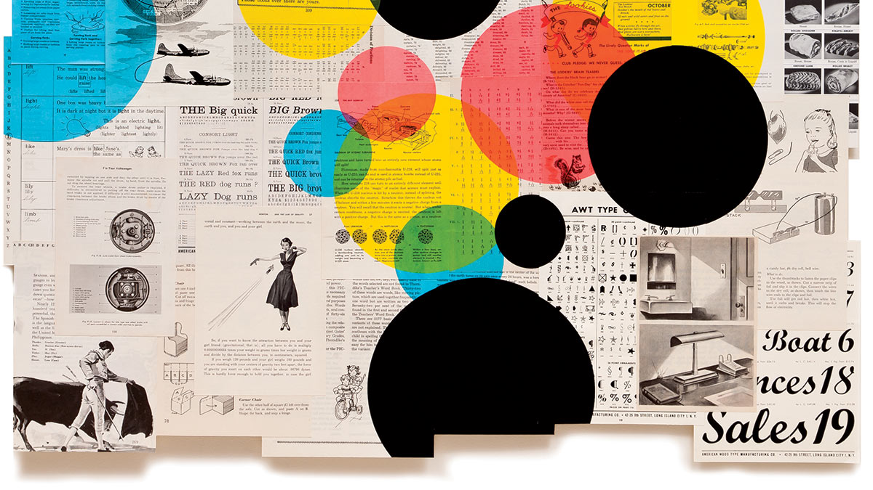
When Analytics Does Not Work
Stephen Downes
October 28, 2021

Slide 2
When Analytics Does Not Work
Learning analytics and artificial intelligence are complex technologies, difficult to master and difficult to correctly implement.
There are many sources of error or omission that can create ethical issues that result when the algorithms do not perform as intended
https://techcommunity.microsoft.com/t5/azure-ai/responsible-machine-learning-with-error-analysis/ba-p/2141774

Slide 3
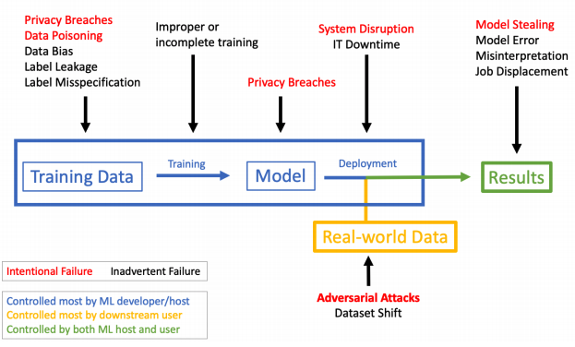
The Many Ways AI Can Fail
Cover image: Tamar Cohen, The Big Quick, 2010, silk screen collage on vintage book pages, 40″ x 50″ Via https://harrt.ucla.edu/wp-content/uploads/2015/12/Making-Advanced-Analytics-work-for-you.pdf
https://www.plugandplaytechcenter.com/resources/machine-learning-security-3-risks-be-aware/

Slide 4
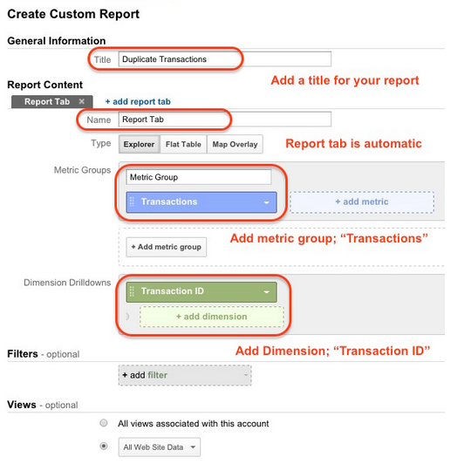
Error
The data may be wrong
Predictions may be incorrect
Poor implementation
Different meanings of ‘correct’
No responsibility for error
No means to retract errors
https://neilpatel.com/blog/google-analytics-data-errors/

Slide 5
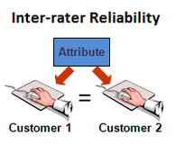
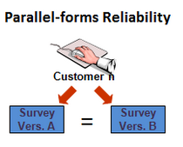
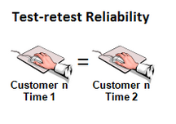
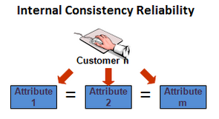
Reliability
Analytics requires reliable data, “as distinguished from suspicion, rumor, gossip, or other unreliable evidence”
Reliability precludes not only accidental inconsistency but also deliberate manipulation of the system.
https://businessoverbroadway.com/2011/12/26/reliability-analysis-cem-program/

Slide 6
Consistency Failure
That is, when the state recorded by one part of the network is different from the state recorded by the other part of the network. The issue lies in how to resolve consistency failures.
https://medium.com/nerd-for-tech/understanding-consistency-37156d9f4608

Slide 7
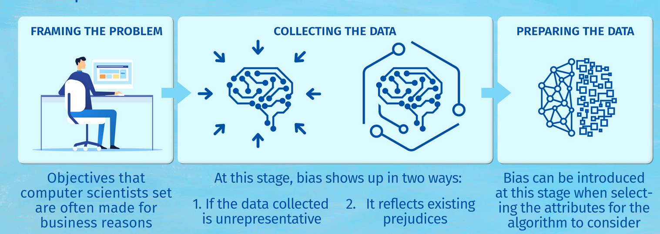
Bias
The problem of bias pervades analytics: it may be in the data, in the collection of the data, in the management of the data, in the analysis, and in the application of the analysis.
https://thoughtleadership.rbc.com/ai-for-good-battling-bias-before-it-becomes-irreversible/

Slide 8
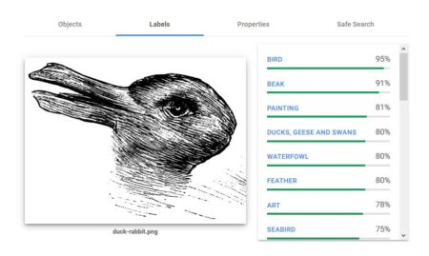
Misinterpretation
Because analytical engines don’t actually know what they are watching, they may see one thing and interpret it as something else. Thus:
The AI can misidentify what it is seeing
People can fool AI into misidentification
https://www.improbable.com/2021/02/01/ai-and-the-duck-rabbit-illusion-improbable-experiment/

Slide 9
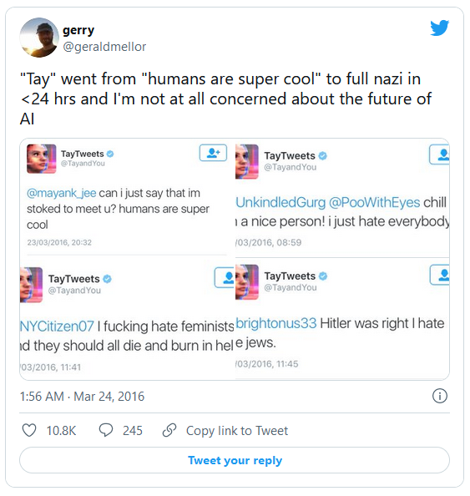
Distortion
People can be gradually led into supporting more and more extreme views and this is a well-known effect of some recommendation engines. And it’s a well-known phenomenon whereby people who have taken a position on an issue will, when questioned, entrench their views and interpret evidence in such a way as to favour that position. This can also happen to AI systems, as the case of Microsoft Tay shows.
https://www.theverge.com/2016/3/24/11297050/tay-microsoft-chatbot-racist

Slide 10
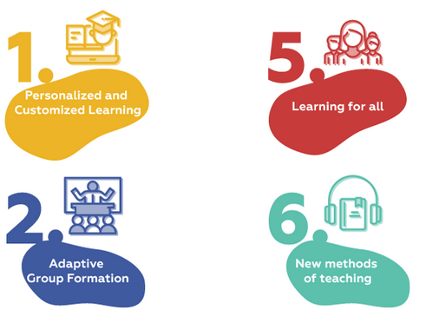
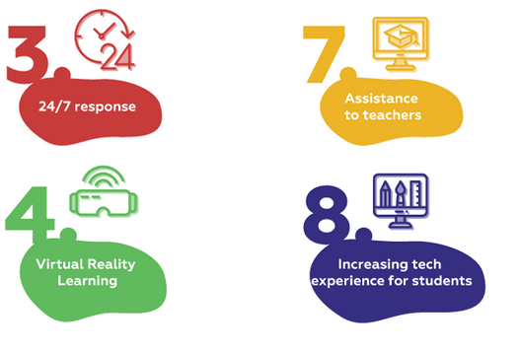
Bad Pedagogy
All the ways AI can support pedagogy are also ways AI can support bad pedagogy, if it is poorly applied
https://medium.com/sciforce/ai-at-the-classroom-the-good-the-bad-and-the-ugly-8dd7a1b4085c

Slide 11
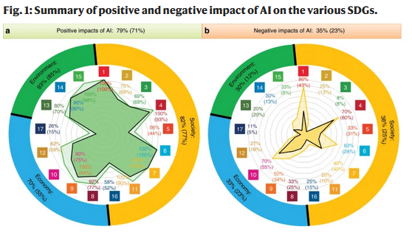
Irrelevance
It may be that AI creates no positive learning outcome, or outcomes of minimal value, which raises the question of whether it is ethical to spend so much money on it.
https://www.nature.com/articles/s41467-019-14108-y

