Slide 1
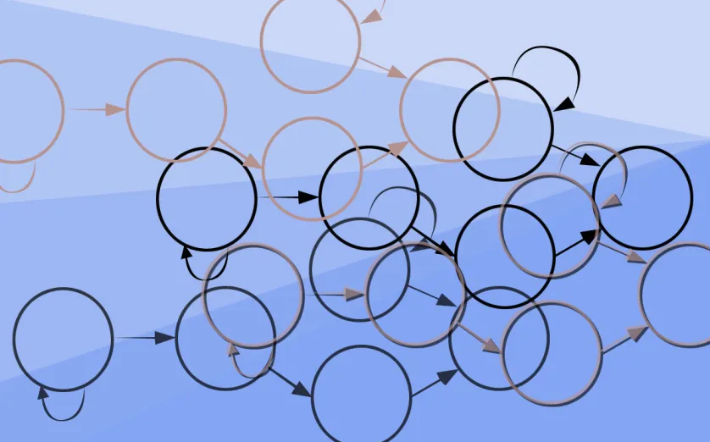
Deontic Analytics
Stephen Downes
October 26, 2021

Slide 2
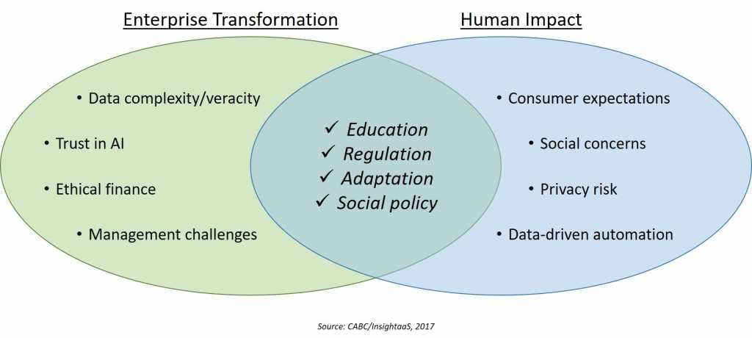
Deontic Analytics
https://insightaas.com/new-research-ai-and-advanced-analytics-connecting-culture-ethics-and-society-in-a-machine-age/
Analytics that look at expressions of sentiments, needs, desires, and other such factors in order to determine what sort of outcome would be best

Slide 3
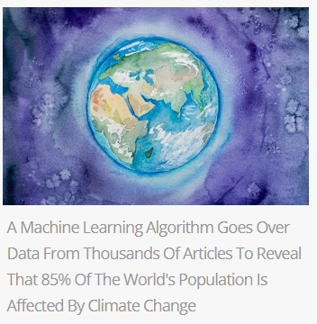
Community Standards
AI interprets and extends human decision-making defining community standards.
For example: Facebook’s system called CLARA (Confidence of Labels and Raters).
https://www.digitalinformationworld.com/2020/08/facebook-new-ai-estimate-the-uncertainty-in-human-generated-decisions-to-improve-its-community-standards.html
https://www.digitalinformationworld.com/2021/10/a-machine-learning-algorithm-goes-over.html

Slide 4
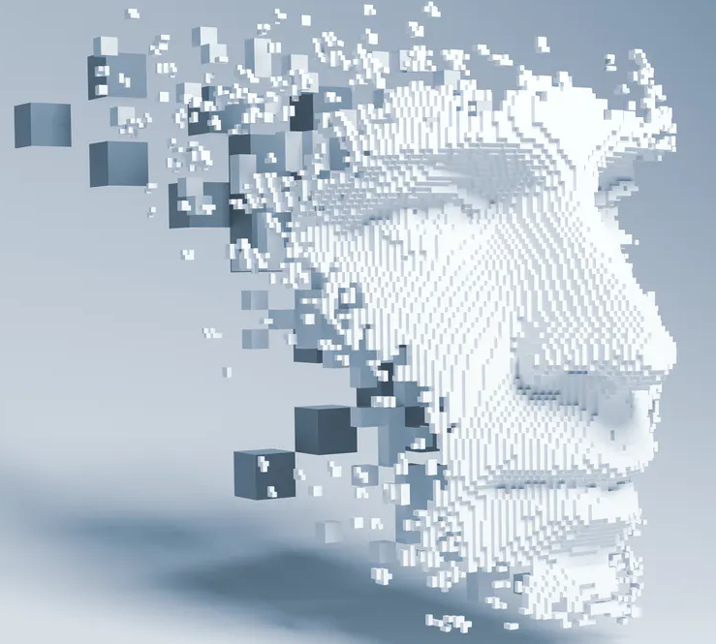
Influencing Human Behaviour
For example, “AI can learn to identify vulnerabilities in human habits and behaviours and use them to influence human decision-making.” Four main social roles:
role model,
advisor,
partner,
and delegate
https://theconversation.com/ai-can-now-learn-to-manipulate-human-behaviour-155031

Slide 5
Identifying the Bad
Patterns and behaviours exhibited by one or more persons may be evidence of bad intentions
E.g. AI-powered lie detector
https://www.technologyreview.com/2020/03/13/905323/ai-lie-detectors-polygraph-silent-talker-iborderctrl-converus-neuroid/

Slide 6
Amplifying the Good
“Everything we love about civilization is a product of intelligence, so amplifying our human intelligence with artificial intelligence has the potential of helping civilization flourish like never before – as long as we manage to keep the technology beneficial.“
Max Tegmark, President of the Future of Life Institute
https://futureoflife.org/background/benefits-risks-of-artificial-intelligence/

Slide 7
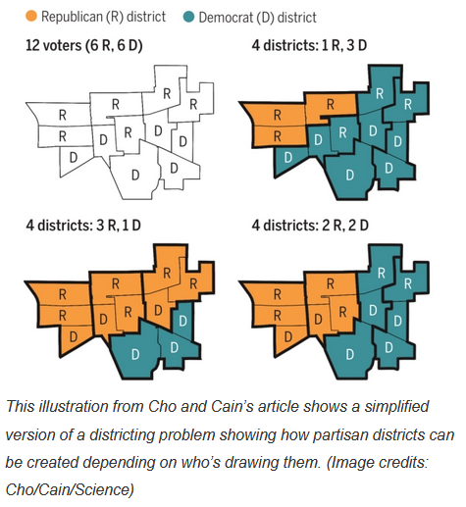
Defining What’s Fair
AI can define what is ‘optimal’ depending on different factors. Examples include fairly redesigning the tax system or creating fair congressional districts.
https://techcrunch.com/2020/09/04/ai-drawn-voting-districts-could-help-stamp-out-gerrymandering/

Slide 8
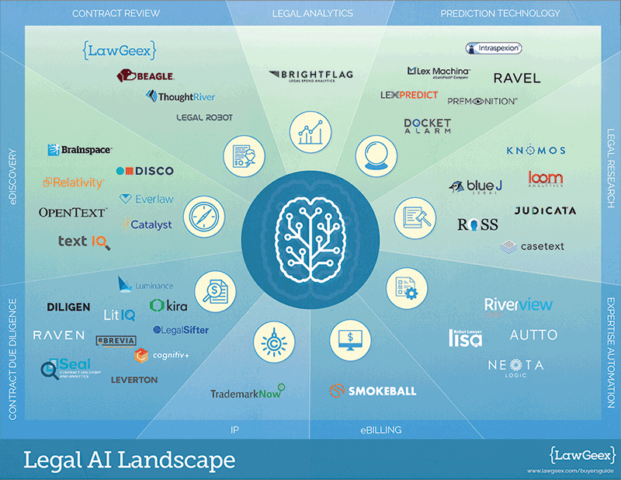
Changing the Law
The existence of AI can cause the creation of new law
The way AI performs can inform the content of that law
https://www.topbots.com/automating-the-law-a-landscape-of-legal-a-i-solutions/
https://www.researchgate.net/publication/342774266_Artificial_Intelligence_and_Legal_Disruption_A_New_Model_for_Analysis

Slide 9
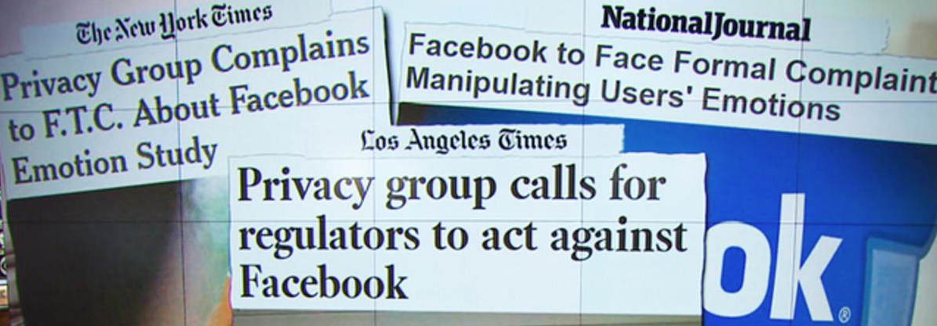
Easing Distress
Applications aim to coach users through crises using techniques from behavioral therapy.
Similar systems could interact with students and modify sentiments and emotions that may be interfering with their learning and socialization – a Fitbit for the mind.
https://www.cbsnews.com/news/controversial-facebook-emotion-study-journal-responds/
https://www.forbes.com/sites/cognitiveworld/2019/12/17/empathy-in-artificial-intelligence/

Slide 10
Moderating Discourse
AI seems like the perfect response to the growing challenges of content moderation on social media platforms: the immense scale of the data, the relentlessness of the violations, and the need for human judgments without wanting humans to have to make them.
https://www.researchgate.net/publication/343798653_Content_moderation_AI_and_the_question_of_scale

