Slide 1
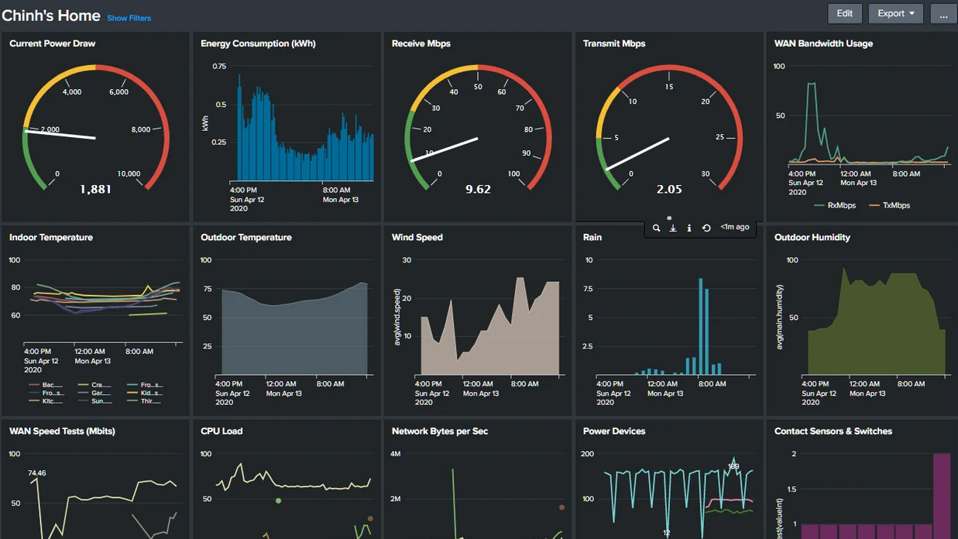
Prescriptive Analytics
Stephen Downes
October 22, 2021

Slide 2
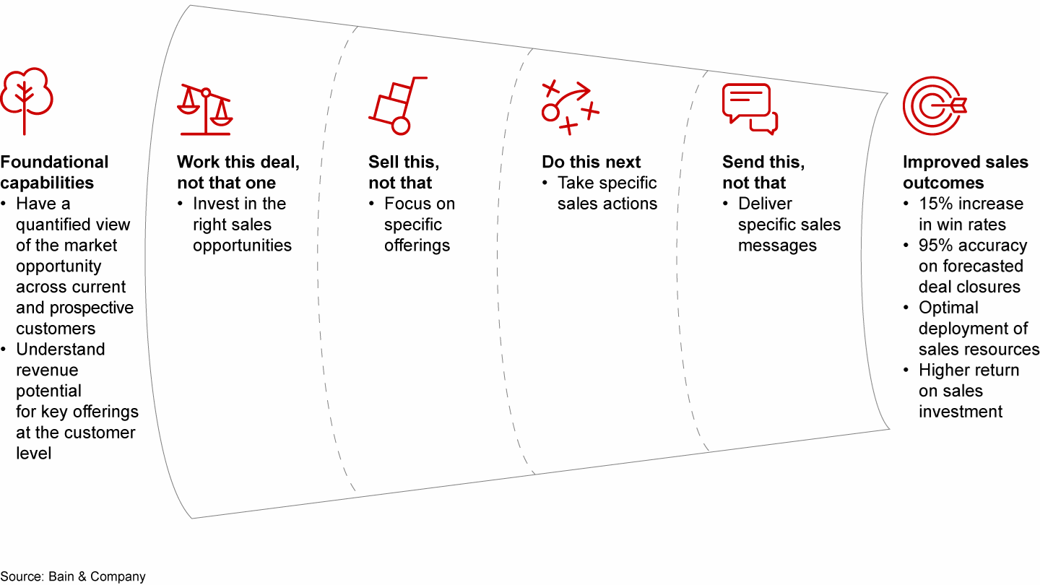
Prescriptive Analytics
Prescriptive analytics recommend solutions.
https://www.bain.com/insights/do-this-not-that-prescriptive-analytics-in-sales-and-marketing/

Slide 3
Learning Recommendations
Content Recommendations
Learning Path Recommendations
https://data-flair.training/blogs/data-science-r-movie-recommendation/
https://www.sciencedirect.com/science/article/abs/pii/S0957417420304206

Slide 4
Adaptive Learning
“The key to making these systems so adaptive is artificial intelligence built into them which monitors student’s inputs and responses and adjusts the difficulty of content accordingly.”
https://trainingeducationmanagement.com/adaptive-learning-equals-personalization/

Slide 5
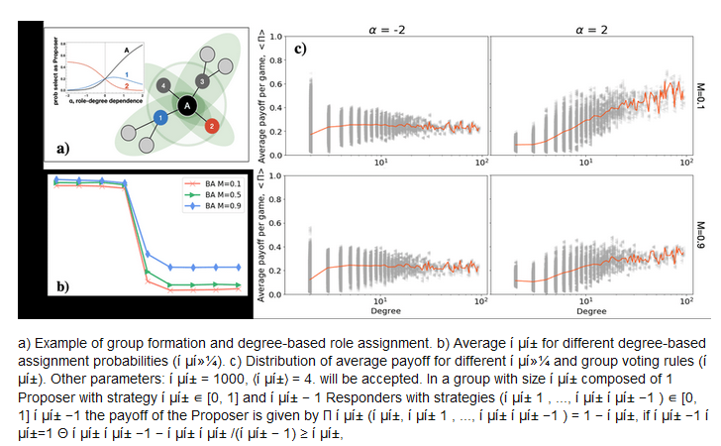
Adaptive Group Formation
In courses with large and variable numbers of people it can be a challenge to assign people to viable groups for tasks or projects.
https://www.researchgate.net/publication/349645705_Eliciting_Fairness_in_Multiplayer_Bargaining_through_Network-based_Role_Assignment_Extended_Abstract

Slide 6
Placement Matching
These are applications that would match students with potential co-op placement.
For example, the Treasury Board of Canada is piloting Micro-missions, which use AI matching to support “short-term, voluntary opportunities for employees to showcase and develop their skills.” (Secretariat, TBS, 2016)
https://miro.medium.com/max/1400/1*LaMfmIN2EEHmnPYdIrU8Xw.png

Slide 7
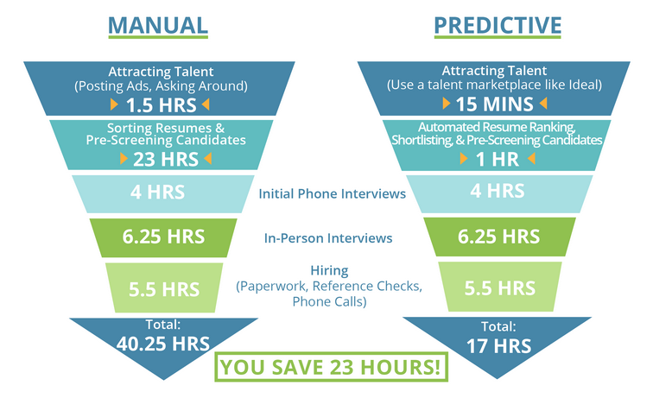
Hiring
“According to Korea Economic Research Institute (KERI), nearly a quarter of the top 131 corporations in the country currently use or plan to use AI in hiring.”
https://ideal.com/predictive-recruitment-analytics/

Slide 8
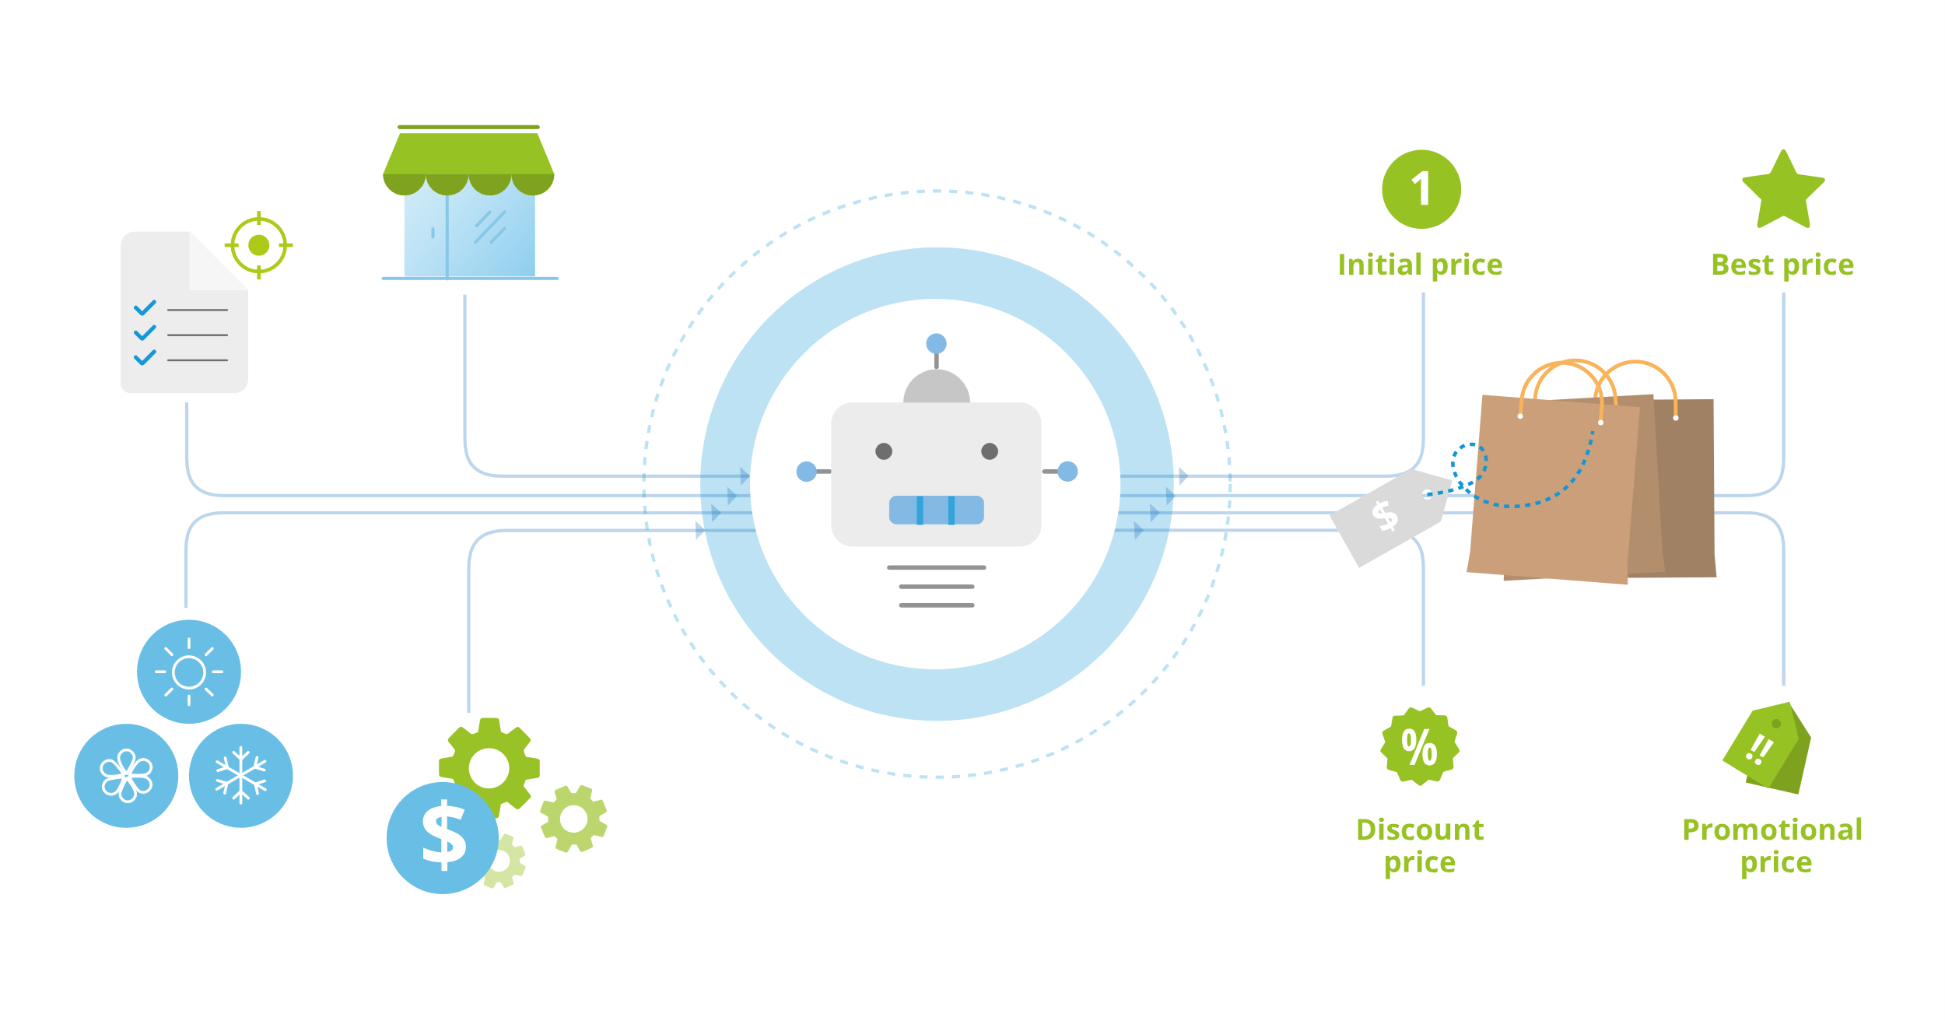
Pricing
Given a new product, a clustering algorithm can quickly associate it with similar products to obtain a probable price segment.
https://tryolabs.com/blog/price-optimization-machine-learning

Slide 9
Decision Making
AI can be trained to find segments in the population that best explain variance at fine-grain levels even if they are unintuitive to our human perceptions. AI has no problem dealing with thousands or even millions of groupings.
https://hbr.org/2019/07/what-ai-driven-decision-making-looks-like

