Slide 1
Predictive Analytics
Stephen Downes
October 21, 2021

Slide 2
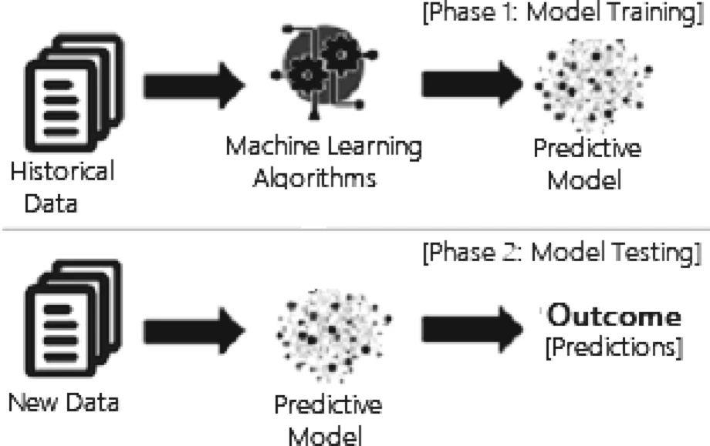
Predictive Analytics
Answer the question, what will (probably) happen, based on an identification of patterns and trends in existing data, and an extrapolation of that pattern or trend to probably future states.
https://link.springer.com/article/10.1007/s42979-021-00592-x/figures/3

Slide 3
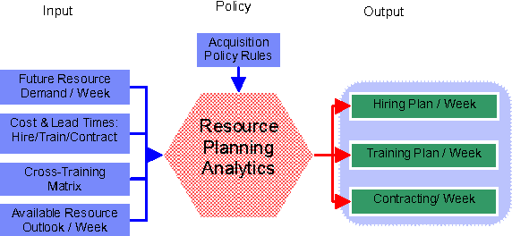
Resource Planning
Examples include predicting website traffic to sport resource issues or working with Twitter data to predict Norovirus outbreaks.
https://www.semanticscholar.org/paper/Optimal-Resource-Action-Planning-Analytics-for-%26-of-Subramanian-An/a77bfb5eebabe9f3a2aadf7434cd8679c1c52f53

Slide 4
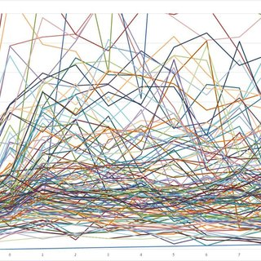
Learning Design
E.g. “Rienties and Toetenel (2016) linked 151 modules taught in 2012–2015 at the OU followed by 111,256 students with students’ behaviour using multiple regression models and found that learning designs strongly predicted Virtual Learning Environment (VLE) behaviour and performance of students”
https://www.researchgate.net/publication/296625925_The_impact_of_learning_design_on_student_behaviour_satisfaction_and_performance_A_cross-institutional_comparison_across_151_modules

Slide 5
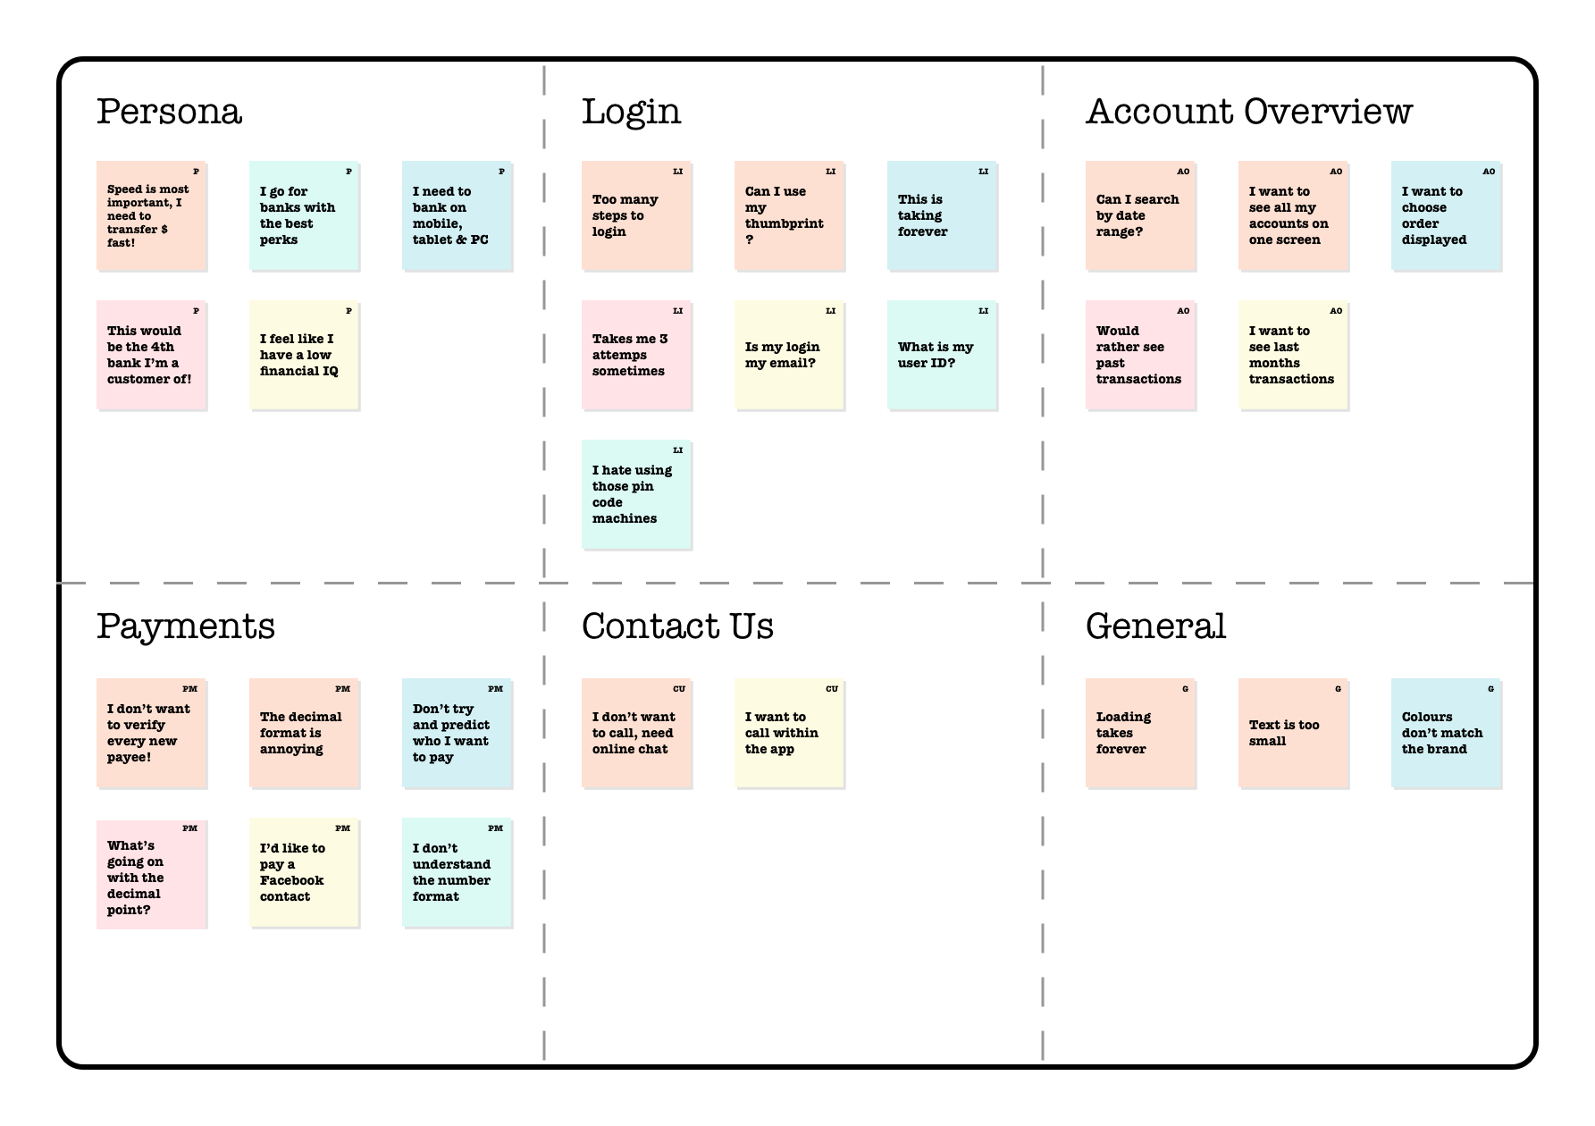
User Testing
For example, Lester Tong and his colleagues (Tong, et.al., 2020) investigated whether “individuals’ neural responses to videos could predict their choices to start and stop watching videos.”
https://uxdesign.cc/analysing-usability-testing-data-97667ae4999e

Slide 6
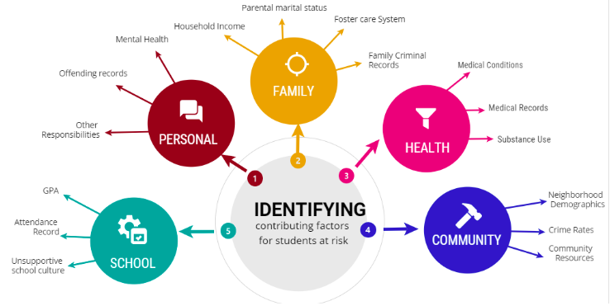
Identify Students At Risk of Failing
https://francesca-bizzarri.medium.com/the-student-net-using-machine-learning-algorithms-to-address-our-failing-guidance-system-f6058b6397ab
“Analytics tools can identify factors statistically correlated with students at risk of failing failing or dropping out.” (Scholes, 2016).

Slide 7
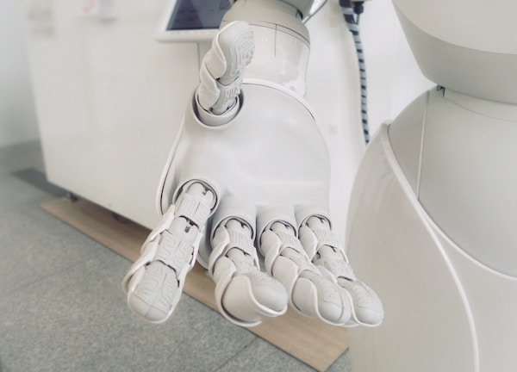
Academic Advising
“There is an opportunity for advisors to incorporate elements of AI into their toolkits, allowing them to free up time to form personal relationships with students.” https://evolllution.com/attracting-students/retention/can-a-machine-imitate-an-academic-adviser-the-impact-of-artificial-intelligence-on-higher-education/

Slide 8
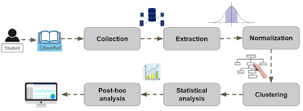
Precision education
https://www.jstor.org/stable/26977864
“The goal of precision education is to identify at-risk students as early as possible and provide timely intervention based on teaching and learning experiences,” write Yang and Ogata (2020).

Slide 9
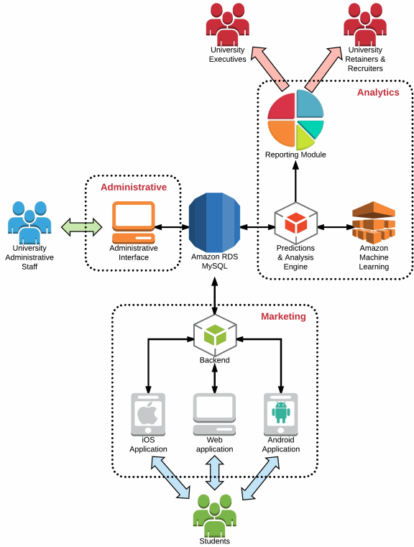
Student Recruitment
“By providing market intelligence throughout each phase of the funnel management process: prospect, inquiry, applicant, accepted, deposited, registered, and matriculant… marketing and recruitment pivots can be made based on changes in students’ responses and Success Indices.”
https://www.clearscale.com/company/cloud-computing-resources/seligo-machine-learning

