Slide 1
Ethics and Analytics: What We Mean By Ethics
Stephen Downes
October 14, 2021

Slide 2
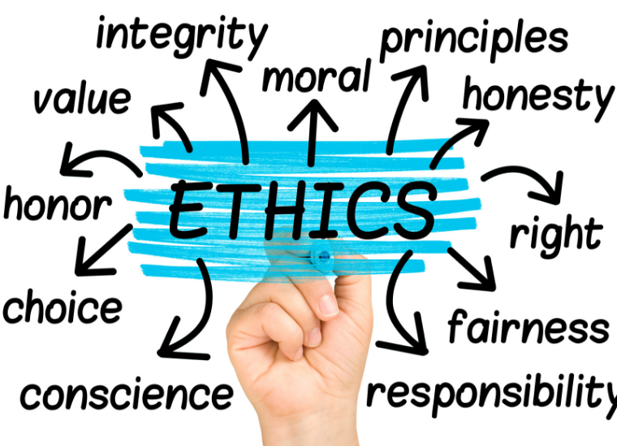
By ‘Ethics’ We Mean…
We all think we know what ethics is.
Each of us feels we have an understanding of ethics and the role it plays in life, but where there is a history of deep and often contentious discussion.
https://www.scu.edu/mobi/resources--tools/blog-posts/ethics-in-life-and-business/ethics-in-life-and-business.html

Slide 3
By ‘Ethics’ We Mean…
The adjective ‘ethical’ can describe both an outcome, a process, or a set of values, any of which has different connotations. (Moss & Metcalf, 2020)
outcome
ethical…
process
values

Slide 4
By ‘Ethics’ We Mean…
Ethics, at first glance, appears to be about how we know what is ‘right’ and ‘wrong’, perhaps as discovered (Pojman, 1990), perhaps as invented (Mackie, 1983), or ‘revealed (Sproul, 2011).
discovered
ethics as..
invented
revealed
Notes:
Sproul - https://www.theaquilareport.com/revealed-ethics/

Slide 5
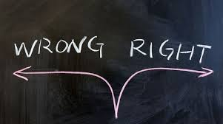
By ‘Ethics’ We Mean…
Maybe it’s about the nature of right and wrong, which might be found in biology, rights, fairness, religion, or any number of other sources, depending on who is asked.
rights
biology
fairness
religion
https://lifehopeandtruth.com/change/sin/deadly-sins/wrong-choice/

Slide 6
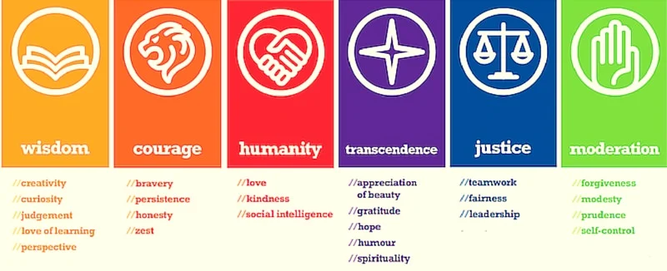
By ‘Ethics’ We Mean…
Or instead, ethics may be based in virtue and character, as described by Aristotle (2014) in ancient Greece.
https://positivepsychology.com/classification-character-strengths-virtues/

Slide 7
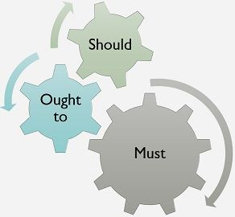
By ‘Ethics’ We Mean…
Ethics is generally thought of as speaking to what actions we ‘should’ or ‘ought’ to take (or ‘should not’ or ‘ought not’ take).
https://keydifferences.com/difference-between-should-ought-to-and-must.html

Slide 8
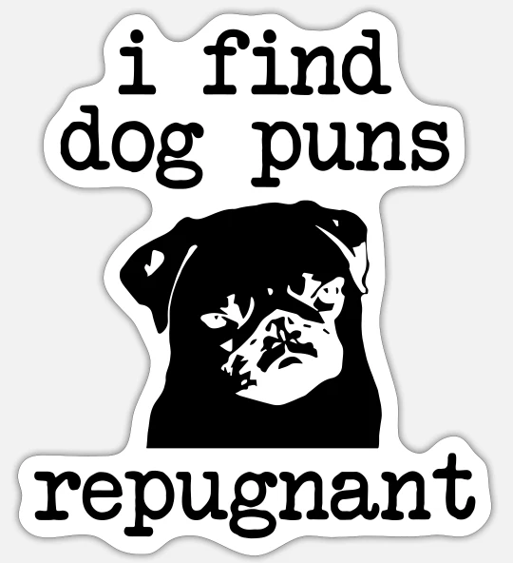
What Ethics Is Not
Ethics is not the same as feeling.
So, for example, we would not say that the word ‘unethical’ means the same as the word ‘repugnant’ or ‘offensive’. These describe our reactions to an action, not the action itself.
(All these cases after Velasquez, et.al., 2009)
https://www.spreadshirt.ca/

Slide 9
What Ethics Is Not
While religion may offer a basis for ethical choices, ethics is not the same as religion.
Maybe we can be ethical without religion (Nielson, 1973)
Maybe we can be religious but unethical
Maybe the domain of ethics extends beyond religion (eg, copyright?)

Slide 10
What Ethics Is Not
While cultural norms may influence our ethical decisions, it is arguable that different cultures define ethics differently.
E.g., example, a compliance-oriented perspective as opposed to a value-oriented perspective (Eisenbeiß and Brodbeck, 2014).
Some cultural practices may appear obviously wrong (Velasquez, et.al. (2009) mention slavery) other differences are much more subtle.
https://study.com/academy/lesson/cultural-norms-definition-values-quiz.html

Slide 11
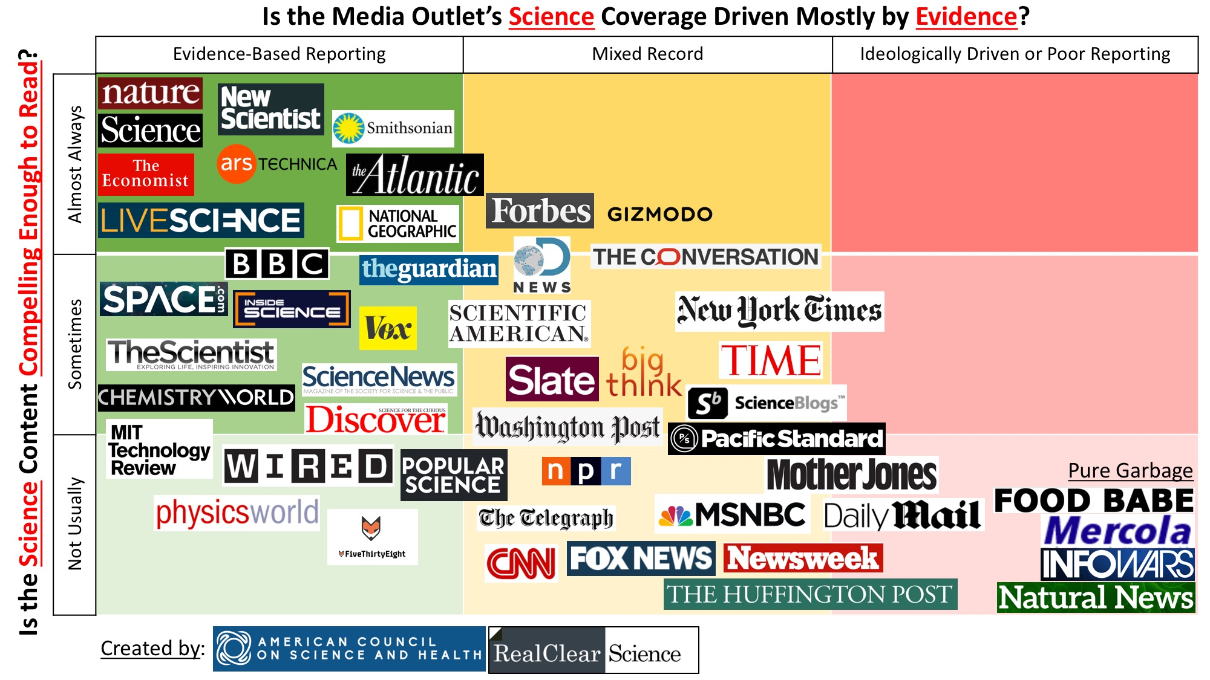
What Ethics Is Not
While science may help us make ethical choices, science does not define right and wrong.
some argue that ‘ought’ does not follow from ‘is’ (Hudson, 1969)
but evidence matters…
https://www.acsh.org/news/2017/03/05/infographic-best-and-worst-science-news-sites-10948

Slide 12
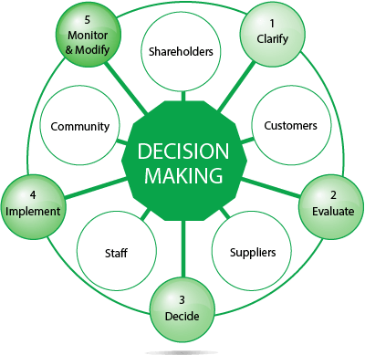
Ethics Might Be…
A framework for making decisions. The idea of analytics and related technology posing dilemmas requiring practitioners to make the right choice (whatever that may be).
https://www.chris-elgood.com/ethical-decision-making-9-steps/

Slide 13
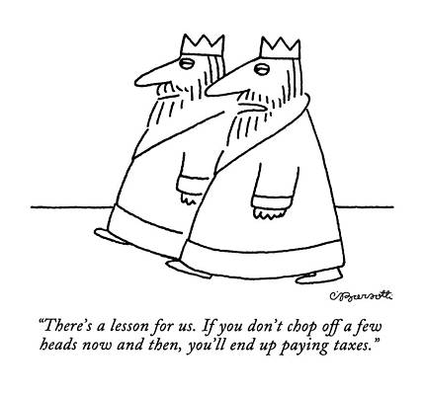
Ethics Might Be…
Inherently political (Selwyn, 2019).
But it does not follow that all political aspects of analytics are also ethical aspects.
https://fineartamerica.com/art/pragmatic

Slide 14
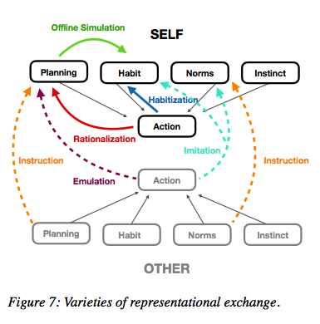
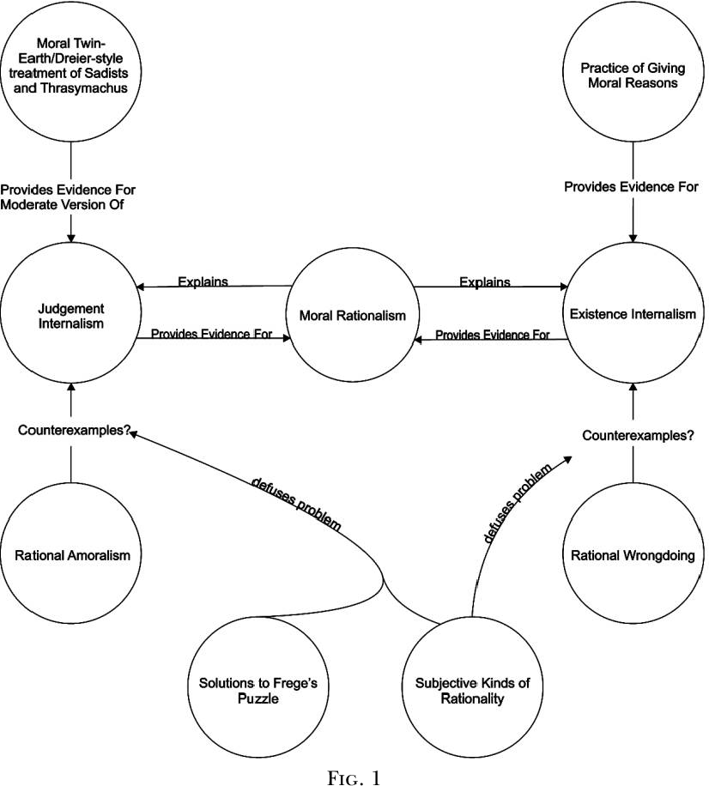
Ethics Might Be…
Rational, or at least, include some sense of rationality and decision-making. As Zawacki-Richter, et. al. (2019:4) write, “the concept of rational agents is central to AI…”
https://www.semanticscholar.org/paper/Moral-Rationalism-and-Rational-Amoralism-Roojen/f5ee34057fe5a5c6af3698a3a4c3e7af0e5ff583
https://www.ethicalpsychology.com/2018/08/rationalization-is-rational.html

